Slide 1


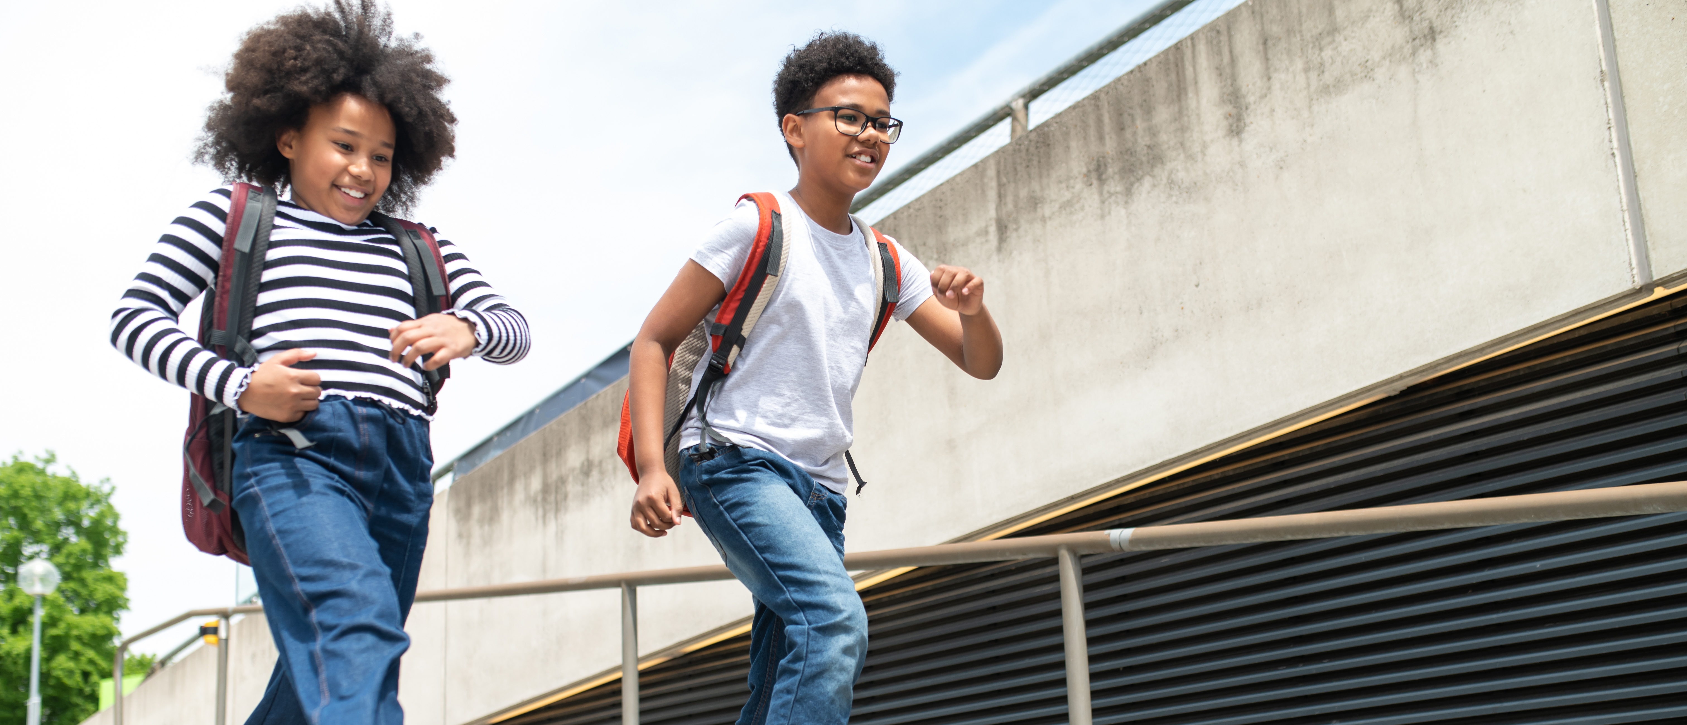
Physical Activity & Emotional Well-being
Instructor Name, Date
Middle Years Development Instrument
Notes:
GUIDANCE
Optional: Customize this slide with the instructor’s name and lesson delivery date
Introduce topic: how movement affects our mood
Briefly explain today’s focus: understanding why physical activity is important and how it helps us feel netter
© 2025 Human Early Learning Partnership

Slide 2
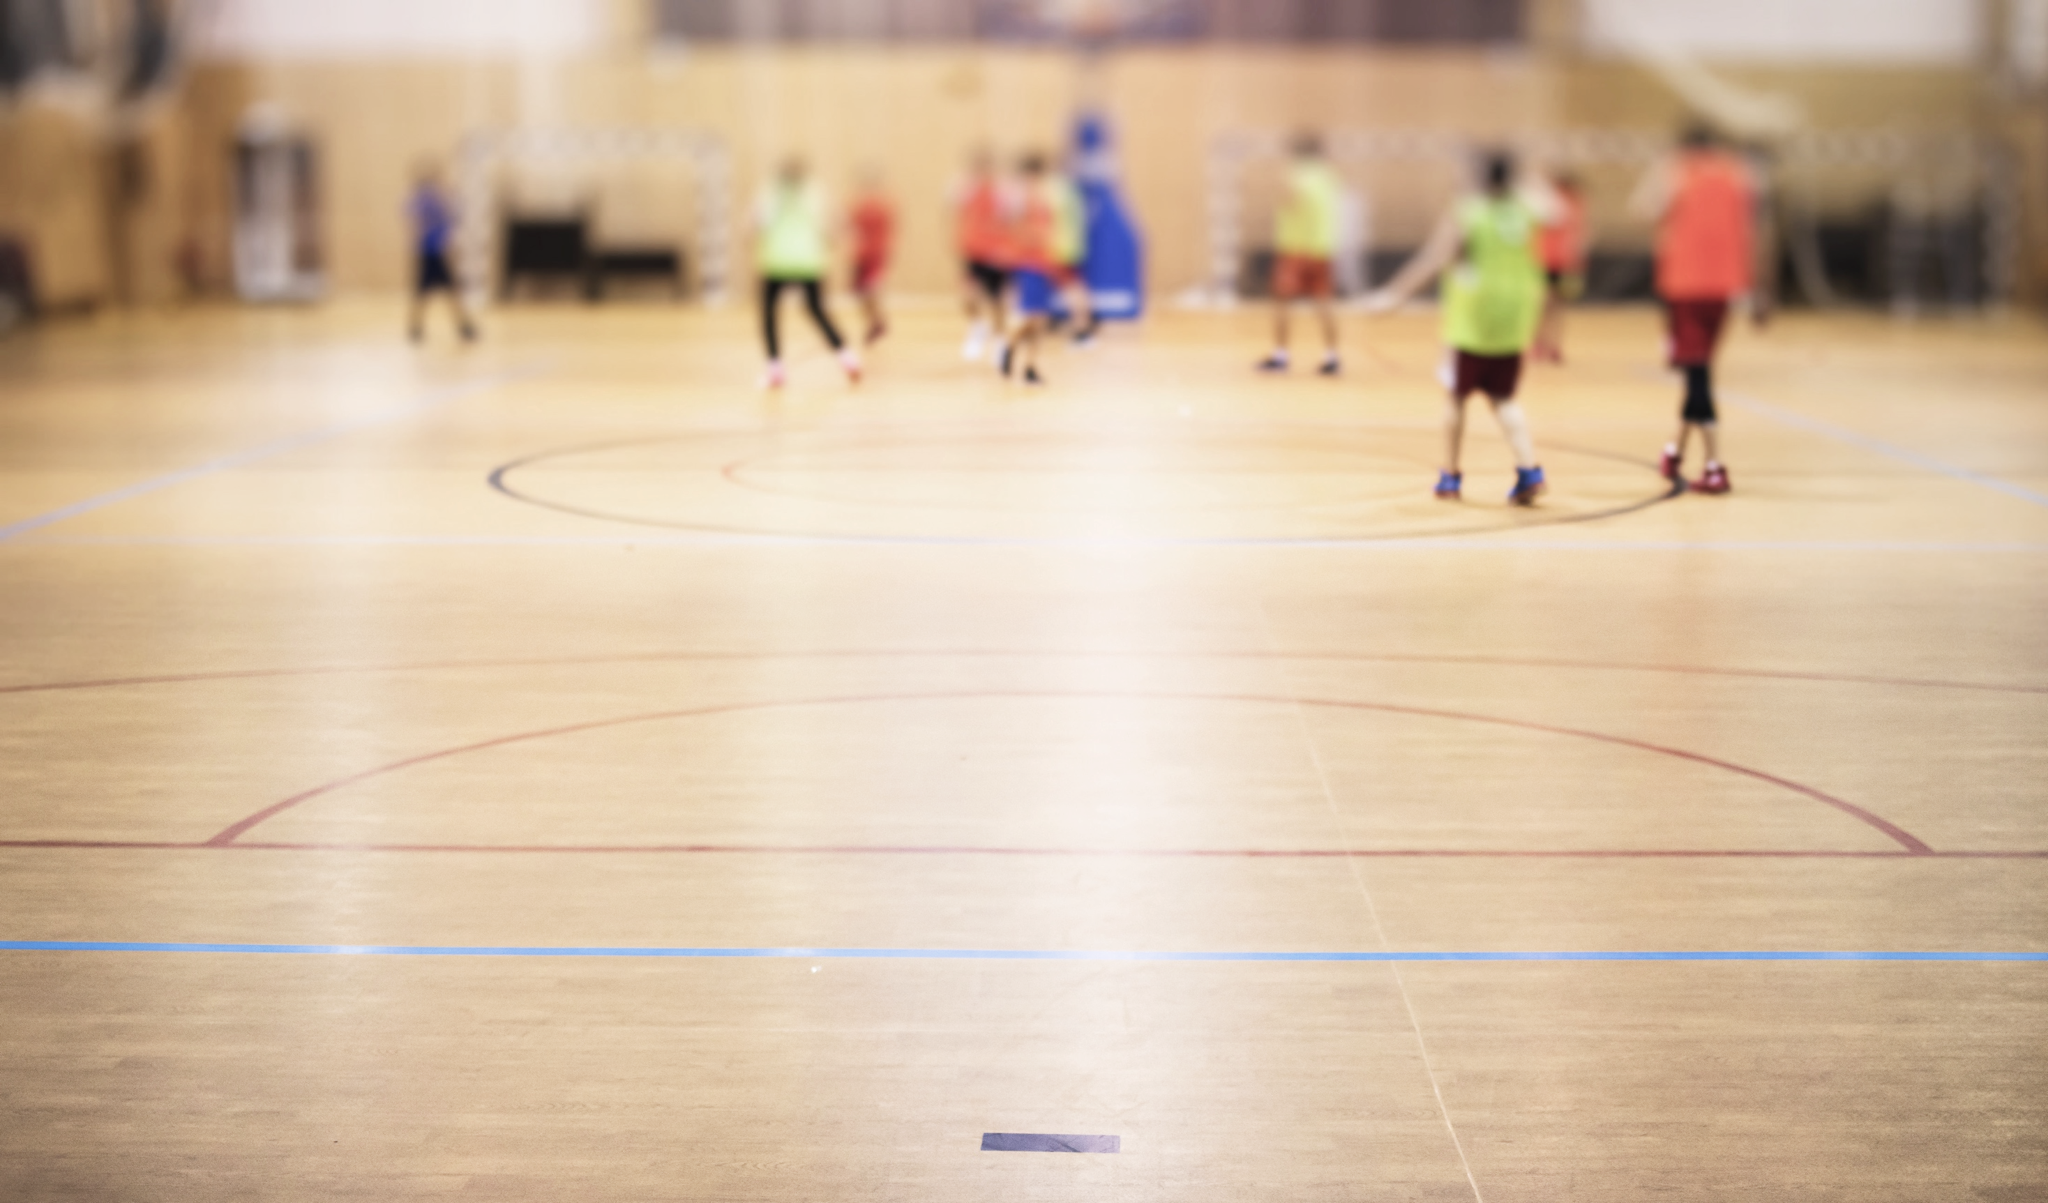
Why is
Physical Activity important?
Helps us feel happy and energized
Improves our focus and concentration
Supports our overall health
The Canadian Society for Exercise Physiology (CSEP) recommends that children 5-17 move for a total of 60 minutes per day
Notes:
GUIDANCE:
Tell students about the reasons movement is important, and that physical activity can benefit many parts of our health including physical, emotional and mental health
Tell students the CSEP guideline is 60 minutes of movement per day for kids 5-17 years old
Ask: what are some ways you like to use your body?
© 2025 Human Early Learning Partnership

Slide 3


Remember your activities add up!
Imagine your day is like a puzzle, and every time you do something active, you add a piece to complete the 60-minute puzzle. You don’t have to do all 60 minutes at once—every bit counts!
For example:
You walk or ride your bike to school for 15 minutes.
At recess, you play tag or kickball for
20 minutes.
After school, you help walk the dog for 10 minutes.
In the evening, you dance to your favorite songs or play a game of basketball with friends for 15 minutes.
When you add it up:
+ 15 (to school)
+ 20 (recess)
+ 10 (dog walk)
+ 15 (dancing/basketball)
= 60 minutes!
So, all the things you do—walking, playing, dancing, or even helping with chores—can add up to help you meet your daily goal. You can split your activity into smaller chunks throughout the day, and it all counts toward feeling stronger, healthier, and more energetic
Notes:
GUIDANCE
Explore the idea that all movements add up throughout the day
Walk through the example (walking to school, recess, etc.)
Emphasize that students don’t have to do all 60 minutes together
© 2025 Human Early Learning Partnership

Slide 4
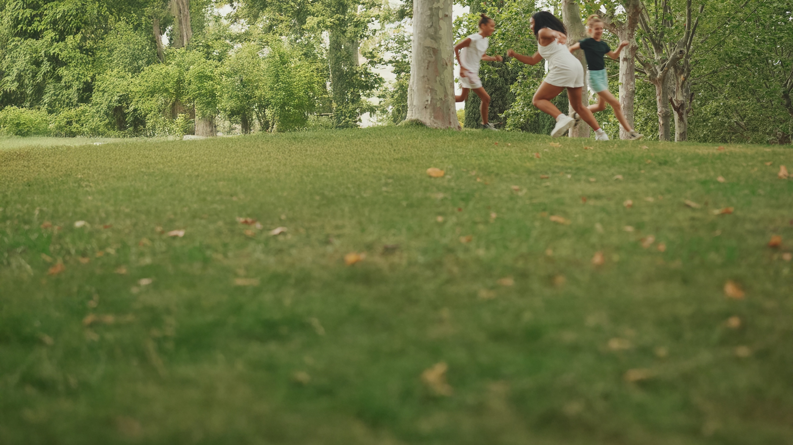
What does the Middle Years Development Instrument tell us?
Regular physical activity is linked to better self-esteem, self-concept, resilience, and overall well-being in children and adolescents
Children who feel better physically are more likely to feel better emotionally and have healthier relationships
Vigorous daily physical activity helps students have a good night's sleep and be more alert and engaged in school
Notes:
GUIDANCE
Introduce MDI: Remind students what the MDI is: The MDI is a survey that allows children to share their thoughts, feelings, and experiences. It helps us understand the well-being of children in BC.
Researchers at UBC who work with the MDI survey found that:
Kids in BC who are more active also said they had better self-esteem and more resilience
Physical and emotional health go hand in hand
Kids who are physically active are more likely to have better quality sleep and feel more alert and ready for school
© 2025 Human Early Learning Partnership

Slide 5
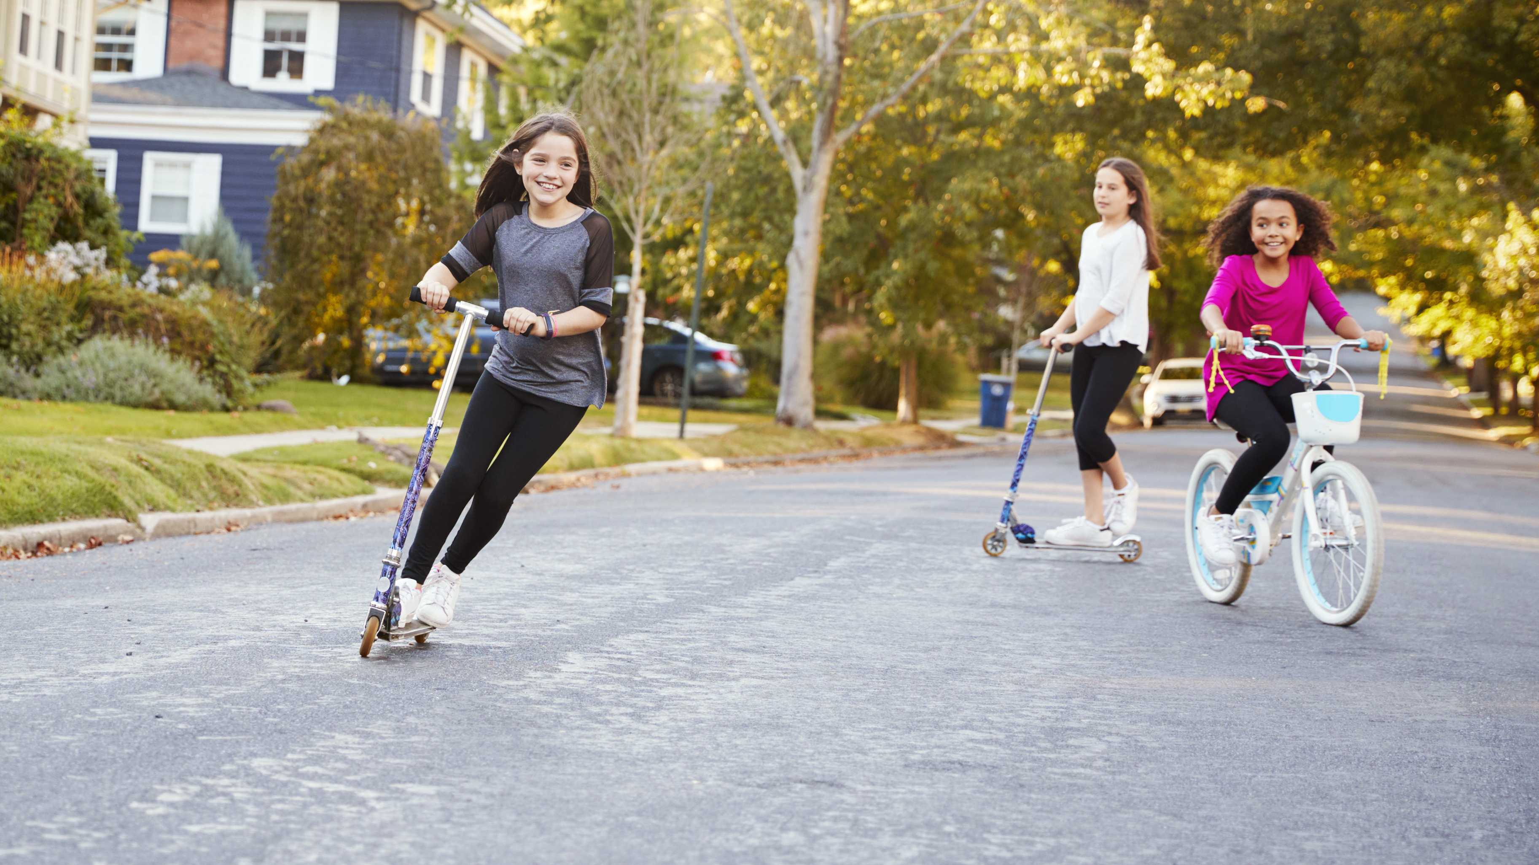
Activity 1: Movement and Mood
Lets move and feel the difference
How do you feel after moving?
Do you feel more energized?
Did your mood change?
Notes:
GUIDANCE
Tell Students:
This week, choose two new physical activities you want to try
On your handout: Write your plan for when and how you’ll try them
Share your choices with the class
© 2025 Human Early Learning Partnership

Slide 6
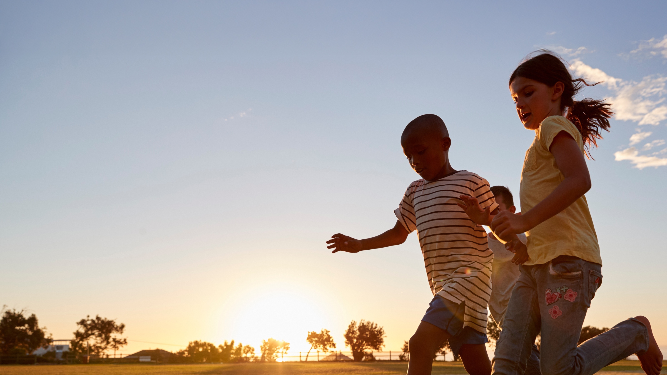
Activities to try out
Activity 2: My Active Week Challenge
On your handout
Write down two activities you would like to try.
Example: this week I would like to try doing tree yoga pose every night
You can choose from this list or come up
with your own ideas:
Dancing to my favorite song
Playing a sport with friends
Going for a bike ride
Trying a new yoga pose
Having a jump rope contest
Creating an obstacle course
Notes:
GUIDANCE
Tell Students:
This week, choose two new physical activities you want to try
On your handout: Write your plan for when and how you’ll try them
Share your choices with the class
© 2025 Human Early Learning Partnership

Slide 7
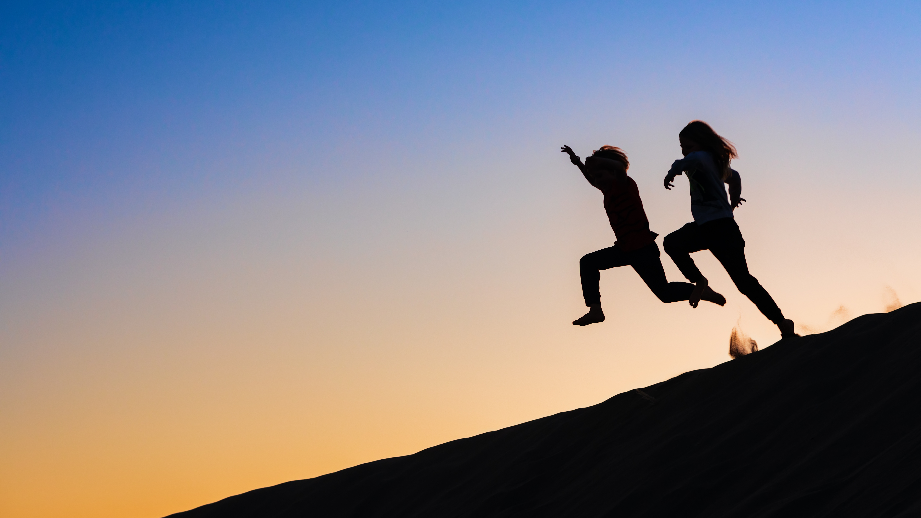
Any movement counts…
find what you enjoy!
Notes:
GUIDANCE
Tell students: today we learned how movement helps our mood and how small activites add up.
Remind: students that all movement counts and to find something they enjoy
Encourage students to try the activities they chose
© 2025 Human Early Learning Partnership

Slide 8
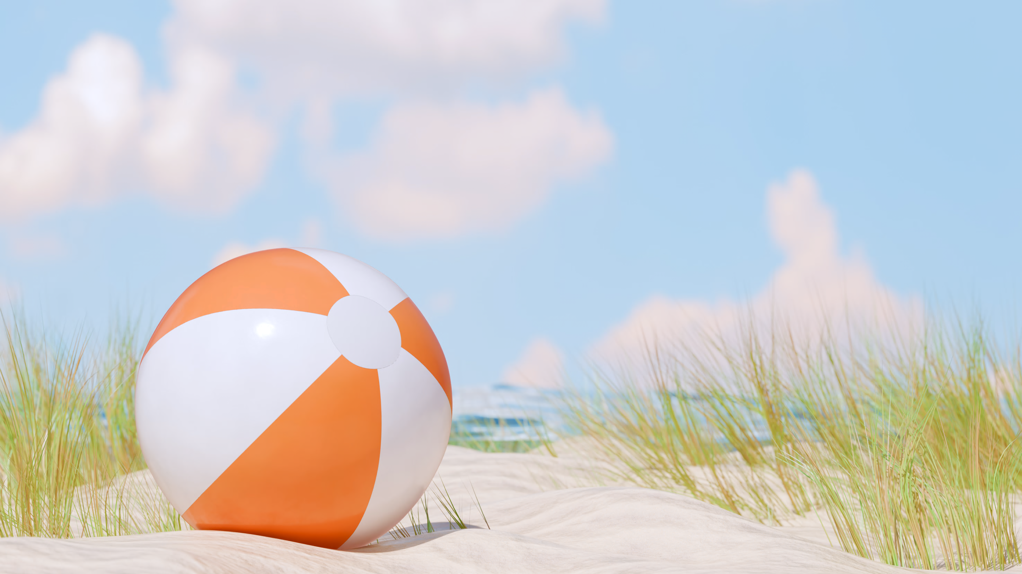
Wrap-Up Activity
What did you learn today?
How did moving make you feel?
Notes:
GUIDANCE
Wrap-Up Activity (optional)
• Ask students to: Write reflective questions on a beach ball, such as What did you learn today? or How did moving make you feel?
• Students pass the beach ball around and answer the question they touch when they catch the ball activities.
© 2025 Human Early Learning Partnership

