Slide 1


Bar Graphs and MDI Data
Instructor Name, Date
Middle Years Development Instrument
Notes:
GUIDANCE
Optional: Customize this slide with the instructor’s name and lesson delivery date
© 2025 Human Early Learning Partnership

Slide 2

Surveys children’s thoughts, feelings, and experiences
Helps understand well-being of children in BC
We will use real data from the MDI to create bar graphs.
Notes:
GUIDANCE
Introduce MDI: Remind students what the MDI is: The MDI is a survey that allows children to share their thoughts, feelings, and experiences. It helps us understand the well-being of children in BC.
Introduce today's lesson: Today, we will be using real data from the MDI to create bar graphs.

Slide 3

What is a Bar Graph?
Definition: A visual representation of data using rectangular bars
Key features: x-axis (categories), y-axis (scale), bars (represent values)
This is a bar graph of the number of children who participated on the MDI in each grade in 2022-2023
Notes:
GUIDANCE
Define Bar Graphs: Explain that a bar graph is a visual representations of data that use rectangular bars to show comparisons between categories.
Key Features: Point out the x-axis (categories), y-axis (scale), and bars (values)
Example: Use the example on the slide-show how many children in each grade completed the MDI in 2022/2023

Slide 4
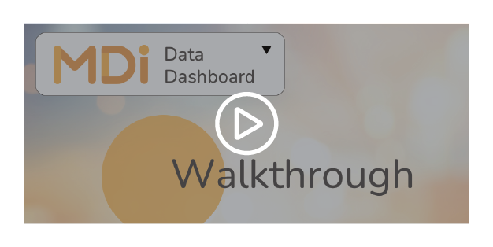
Creating a Bar Graph | Step 1: Getting Your Data
https://mdi.dashboard.earlylearning.ubc.ca/
Let’s do the MDI Data Dashboard guided tour
Notes:
Access Data: Guide students to the MDI Data Dashboard (mdi.dashboard.earlylearning.ubc.ca)
Guided Tour: Walk students through the dashboard, showing how to select school districts, years and grades
The following 5 slides do a walk through of the MDI data dashboard you can show in class

Slide 5
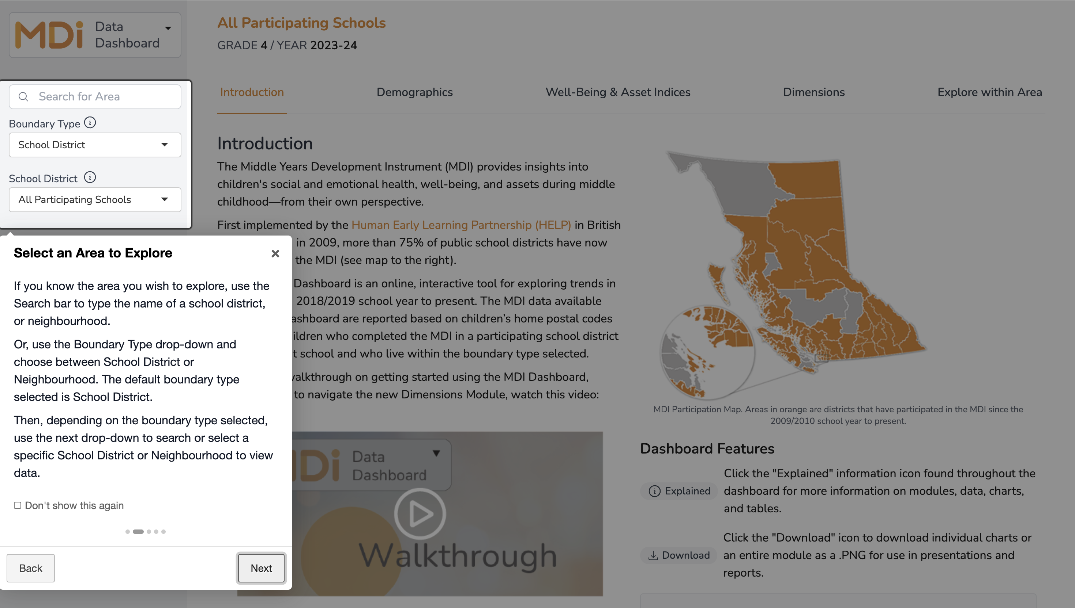
Getting Your Data | Choose a School District or Neighborhood on the left
Notes:
GUIDANCE:
Tell Students: we will go through the process together of how to find your data on the MDI Data Dashboard step-by-step
Step-by-Step:
Choose School District/Neighborhood: Select from the left menu

Slide 6
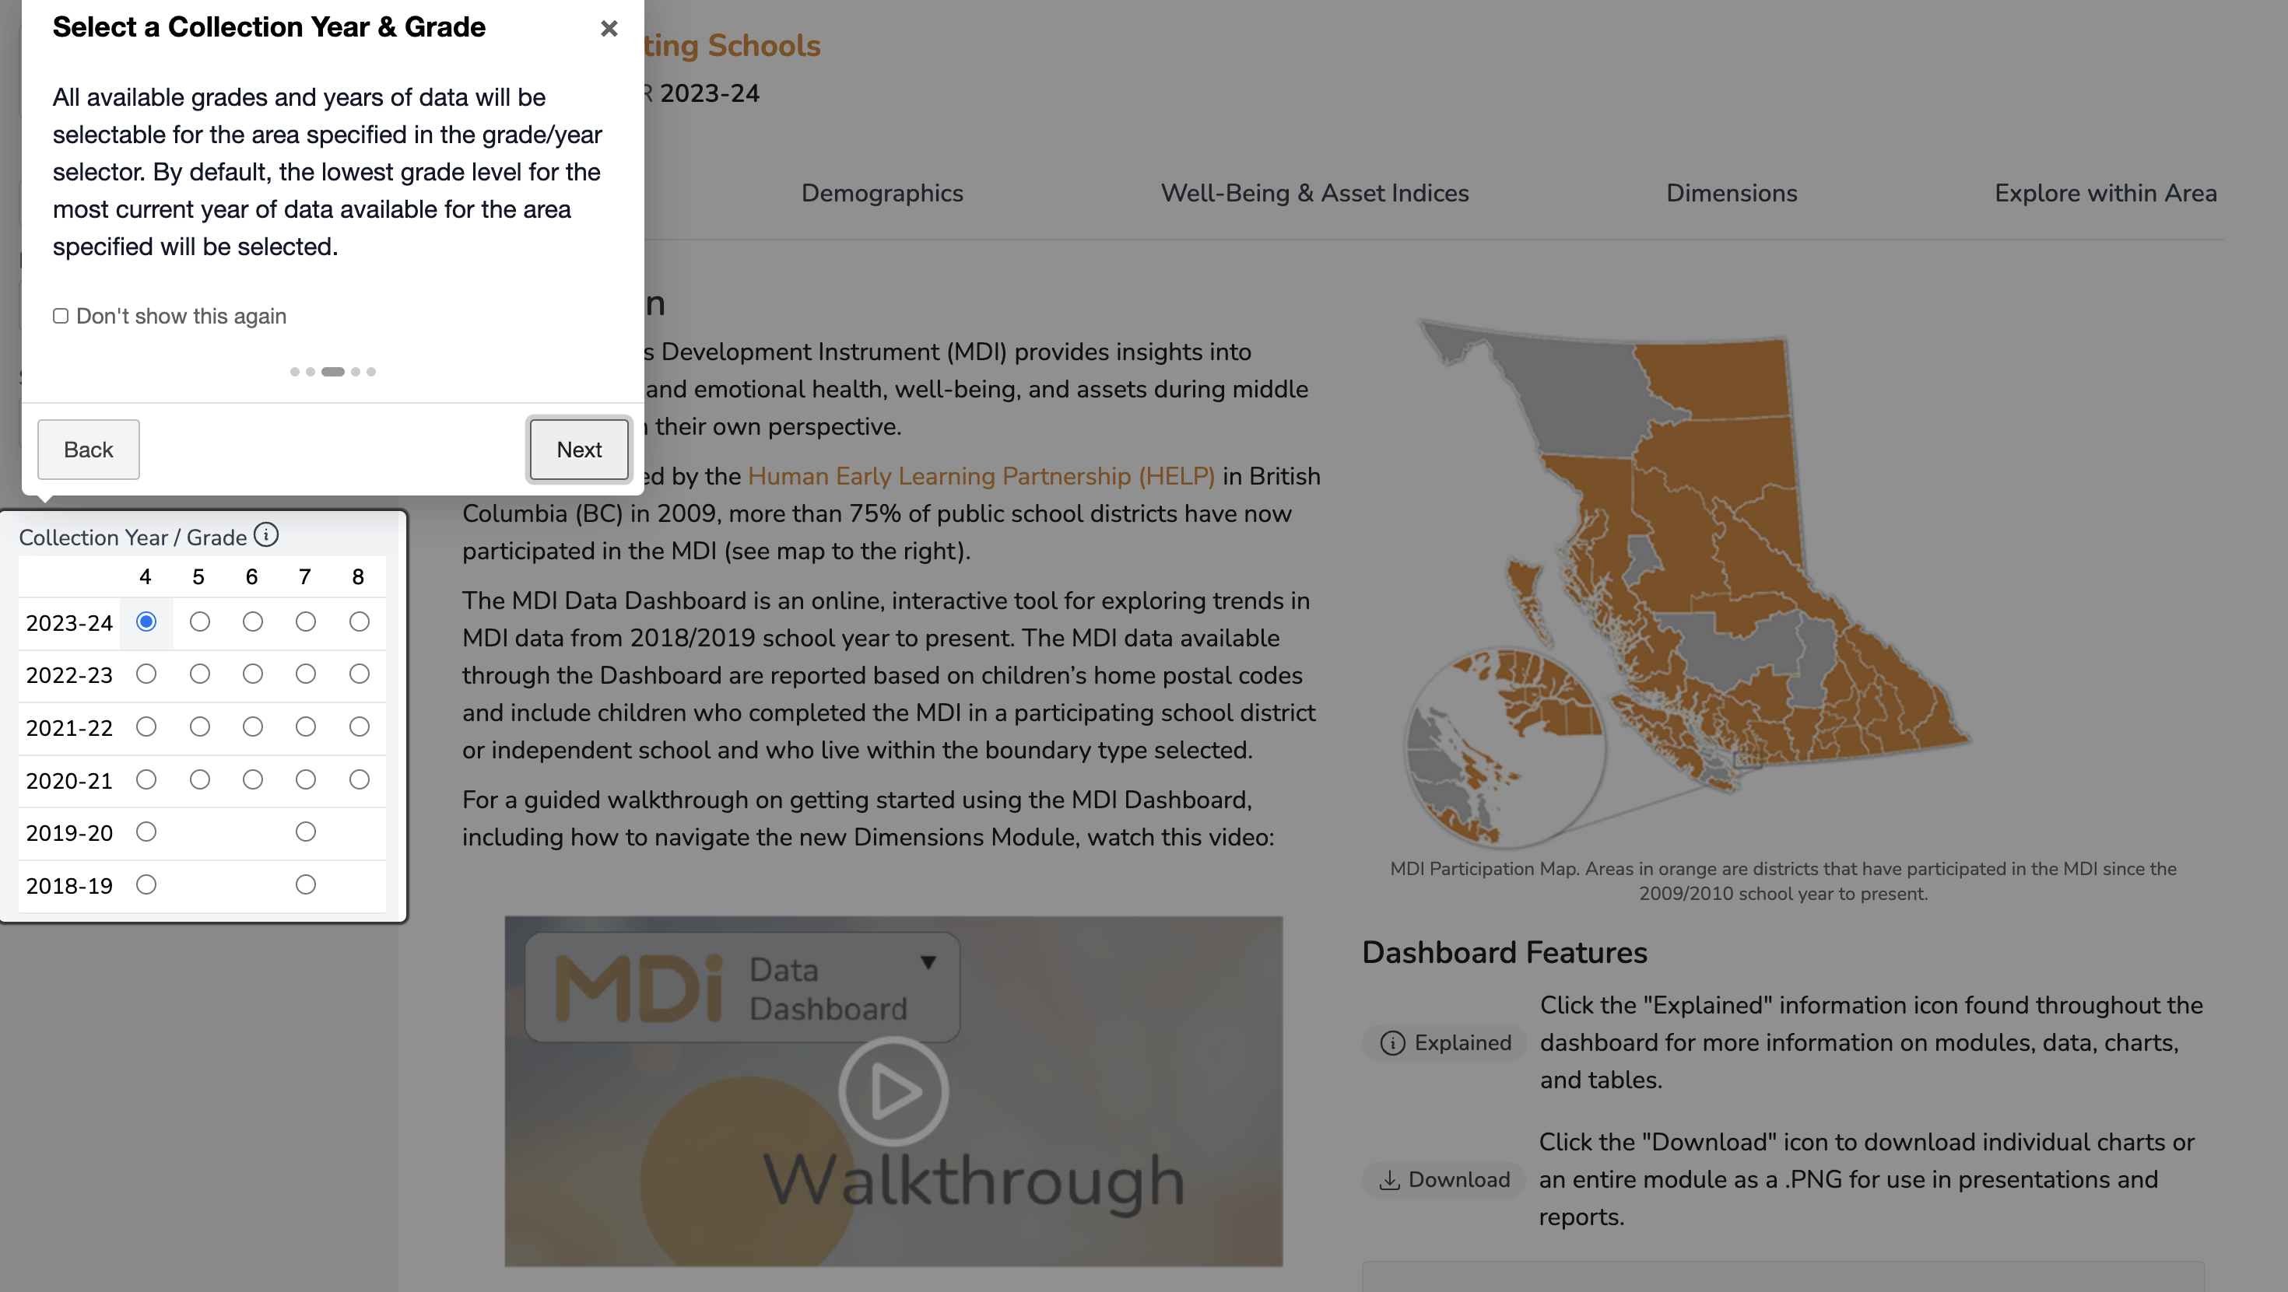
Getting Your Data | Choose the Year and Grade
Notes:
Step-by-Step:
Choose School District/Neighborhood: Select from the drop-down menu on the lleft
Choose Year and Grade: Click on year and grade you would like to explore

Slide 7
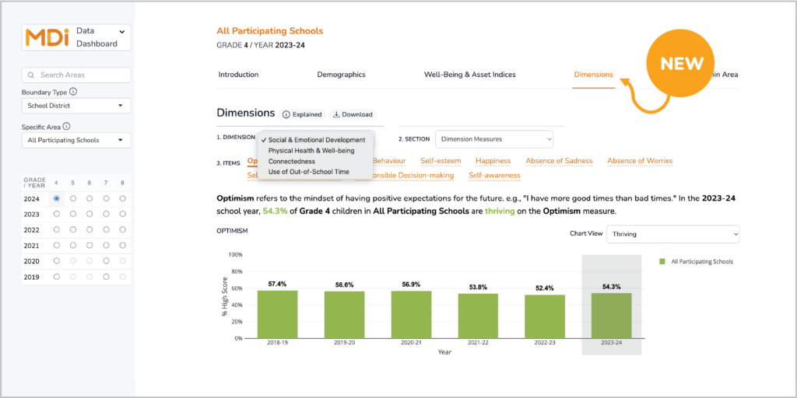
Getting Your Data | Find the item you’re interested in
Click on Dimensions
Choose the dimension you would like to explore from the drop-down menu (e.g., Social & Emotional Development)
Choose section (e.g., Dimension Measures)
Click on the item you want from the orange list (e.g., Optimism)
Notes:
Step-by-Step:
Choose School District/Neighborhood: Select from the left menu
Choose Year and Grade: Use the drop-down menus to select year and grade
Select Dimension: Click on “Dimensions,” and select a dimension (e.g., Social and Emotional Development)
Choose a Section: choose one of the sections (e.g., Dimensions)
Select an item: Click on the item you want from the orange list (e.g., Optimism)
In this example:
Clicked on all participating schools
Selected Grade 4 and the year 2024
Selected Dimension: selected Social & Emotional Development
Clicked on Dimensions
Selected Item from the orange list: Optimism

Slide 8
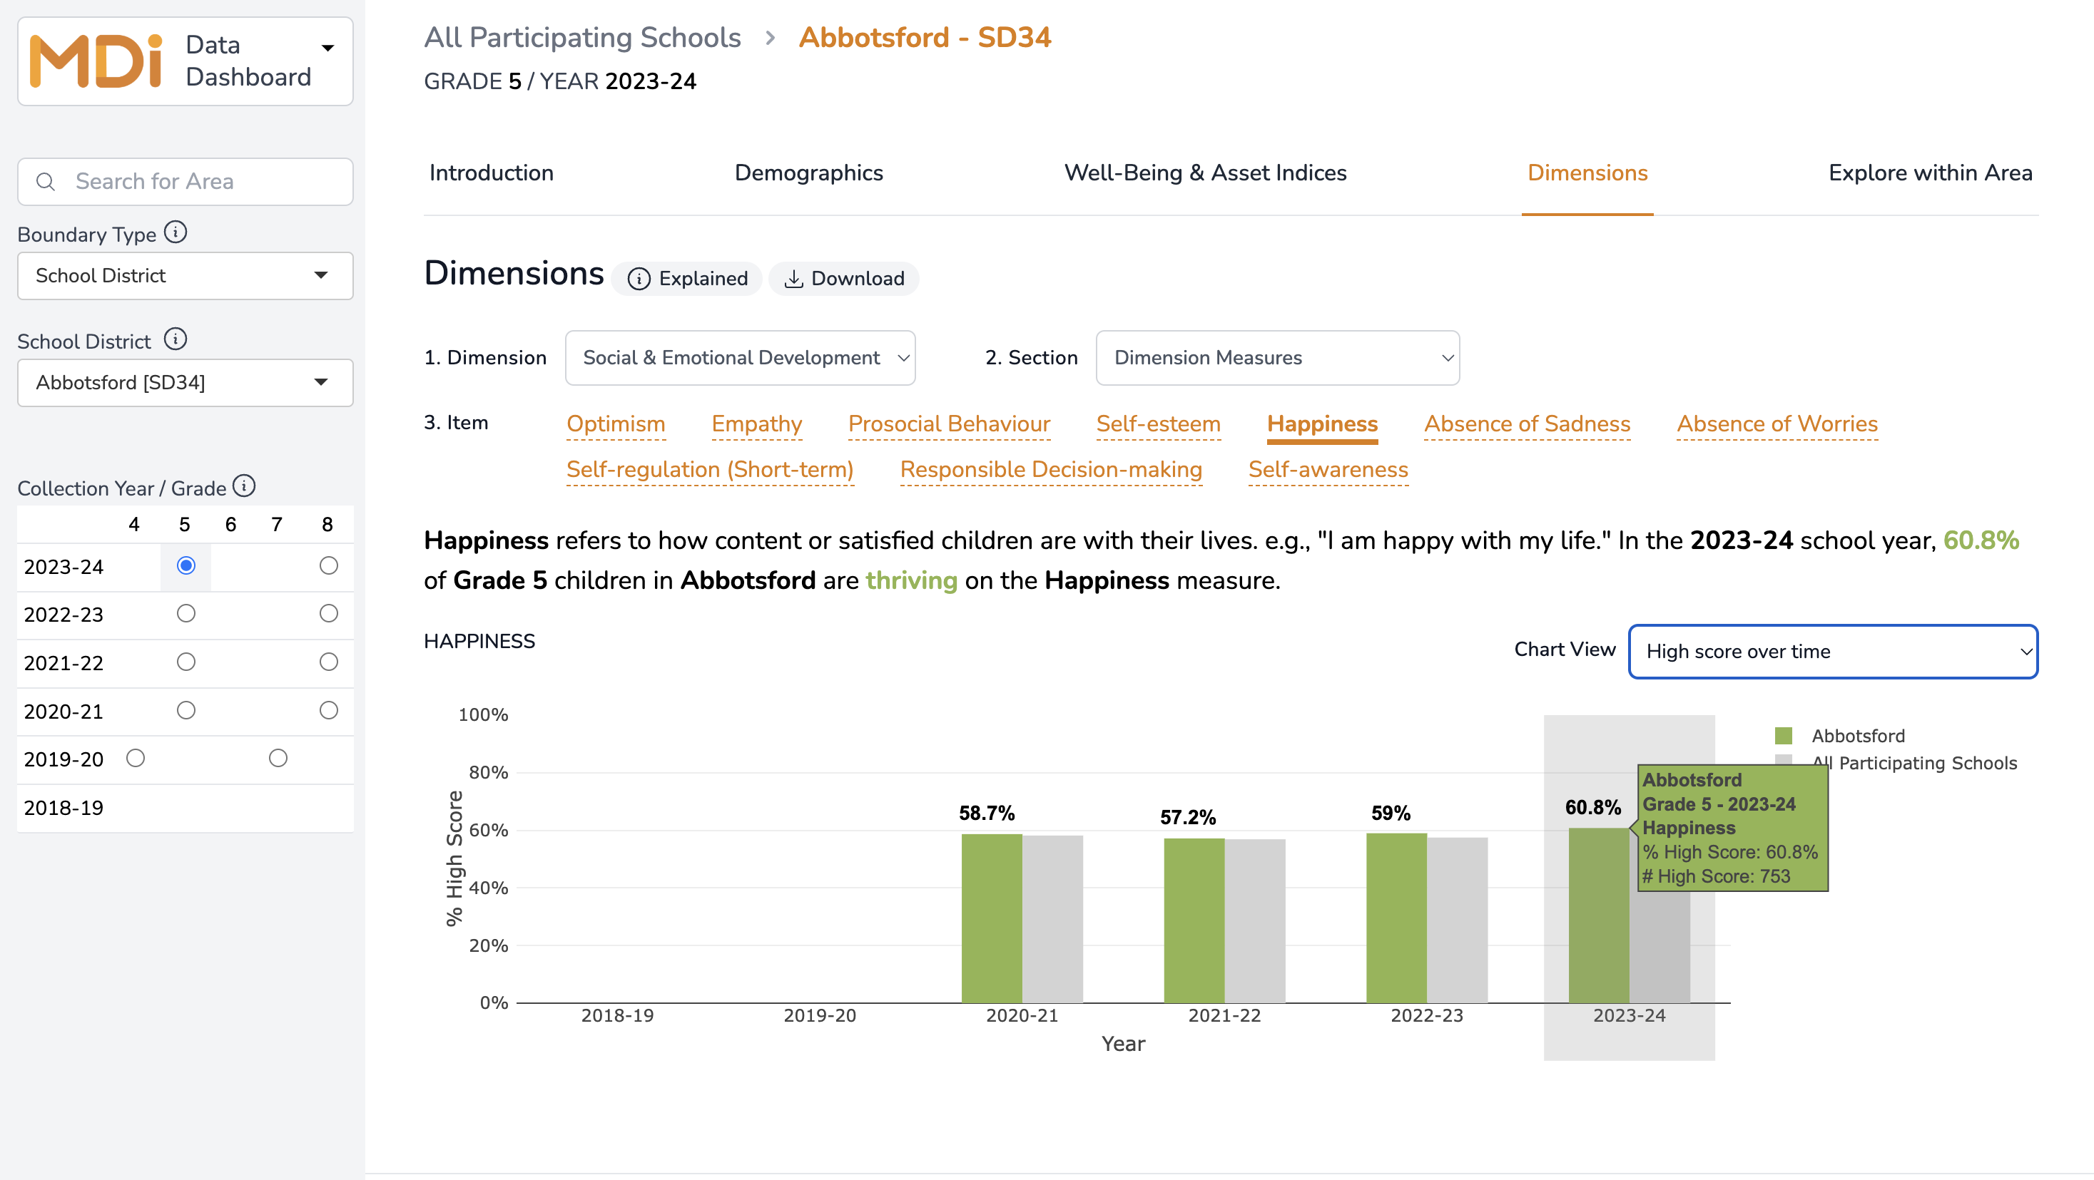
Tip 1:
To get the number of students in each bar in your graph, hover over it with your mouse and you will get the number of kids in each bar
Notes:
GUIDANCE
Remind:
tell students that the categories on the x-axis are years in this example
The scale on the y-axis is measuring the Students with a High Score on Happiness
The Values of each bar graph are the percent of students with a high score on Happiness in each year
Explain: to get the values of each bar in the bar graph, you can look at the top of each bar. A tip on the dashboard is you can also hover the mouse over the the bar and get the value. In this example, if we hover the mouse over the 2023-24 green bar I can see that 753 students are thriving on happiness

Slide 9
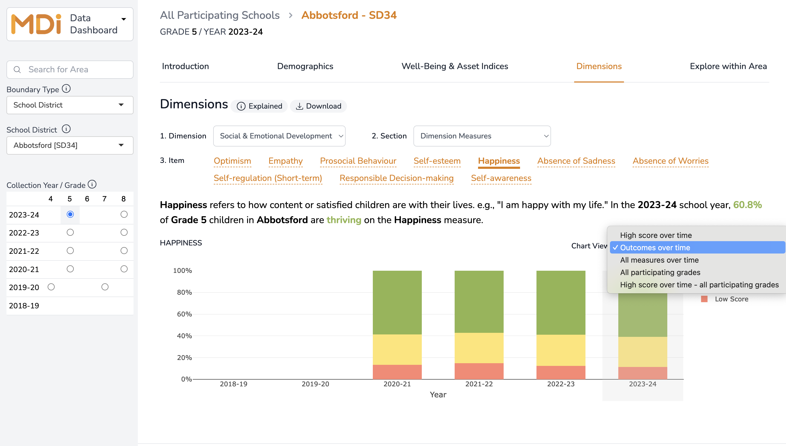
Tip 2:
Click on the chart view drop down menu to see different types of data. For example, when I click Outcomes over time, I can see Low, Medium and High levels of Happiness
Notes:
GUIDANCE
Explore Data Types: Demonstrate how to use the chart view drop-down menu to see different data representations (e.g., Outcomes over Time, High score over time)

Slide 10
Activity | MDI Data Dashboard Scavenger Hunt
In groups of 4:
Go to the MDI Data Dashboard
https://mdi.dashboard.earlylearning.ubc.ca
Find the percent of students in Grade 5 in the Sunshine Coast school district in 2023-24 who had a high score for eating breakfast
Find the percent of students in Grade 8 in Revelstoke school district in 2022-23 who had a high score on optimism
Notes:
GUIDANCE:
Group Activity: Divide students into groups of 4
Scavenger Hunt Tasks:
Go the the MDI data dashboard (mdi.dashboard.earlylearning.ubc.ca)
Find percent of Grade 5 students in Sunshine Coast (2023-24) who had a high score for eating breakfast (Answer: 76%)
Find the percent of Grade 8 students in Revelstoke (2022-23) who had a high score on optimism (Answer: 36.8%)

Slide 11

Example| Levels of Happiness for Grade 5 students
in Abbotsford in 2023/2024
Steps:
Go to MDI Data Dashboard
Select Abbotsford school district from the drop-down menu on the left
Click on Grade 5 and 2023/2024
Click on Dimensions
Select Social & Emotional Development from the Dimension drop down
Click on Happiness
Notes:
GUIDANCE
Model the Process: This is an opportunity to go through the steps with students to create the graph on the next slide.
Follow the steps on the slide and show students how to find data for Levels of Happiness for Grade 5 Student in Abbotsford
This is an opportunity to show students how they can complete the main activity and worksheet
Steps:
Get Data: Use the MDI Data Dashboard to collect data
Choose School District/Neighborhood: Select Abbotsford from menu on the left
Choose Year and Grade: Use the drop-down menus to select 2023/2024 and grade 5
Select Dimension: Click on “Dimensions,” and select Social and Emotional Development
Choose a Section: Click on Dimensions
Select an item: Click on the Happiness from the orange list

Slide 12
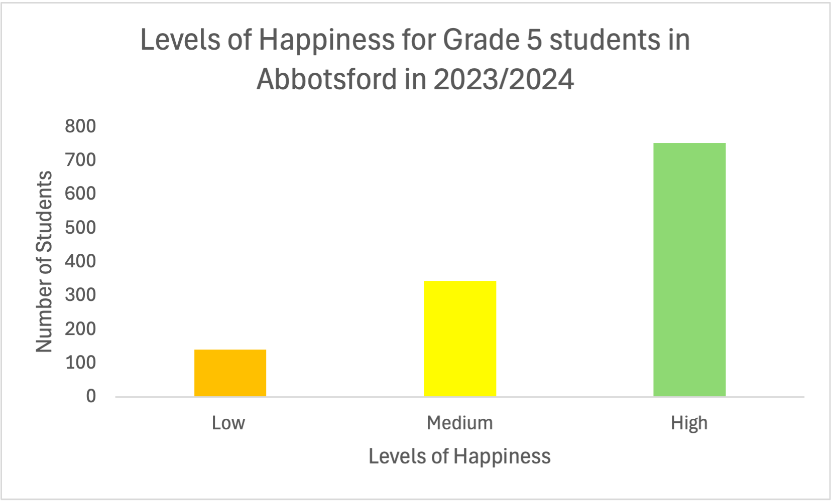
Example | Creating a Bar Graph from MDI data using the
MDI Data Dashboard
Steps
Label Axes: x-axis
(Levels of Happiness); y-axis (Number of Students)
Draw bars: Plot bars for Low, Medium and High
Add title: Give the graph a clear title
Optional: add colors to bars
Notes:
GUIDANCE:
Tell students: From the data we just retrieved from the MDI data dashboard we can create a bar graph for levels of Happiness for Grade 5 students in Abbotsford in 2023/2024
These are the Steps:
Label Axes: x-axis = Levels of Happiness; y-axis = Number of Students
Draw Bars: Plot bars for Low, Medium, and High happiness.
Add Title: Give the graph a clear title.
Optional: Add colors to the bars.
Interpret the Data:
Y-axis scale is measuring the Levels of Happiness for Grade 5 Students in Abbotsford
Values of each bar are color coded to show the number of students with high (green), medium (yellow), and low (orange)
Analyze: Discuss what the graph shows about student happiness.

Slide 13
Activity | Creating a Bar Graph from MDI data using the
MDI Data Dashboard
Go to the MDI data dashboard to get your data
Draw and label your x and y axes
Plot data points and draw bars
Add title and colors (optional)
Analyze your graph
Notes:
GUIDANCE
This is the main activity of the lesson that can be completed in a subsequent lesson
Instruct students to use the handout Bar Graph Worksheet: Exploring MDI Data
Optional: you can assign dimensions to students or allow students to explore a dimension of interest
Remind: remind student of steps:
Get Data: Use the MDI Data Dashboard to collect data.
Label Axes: x-axis = Levels of Happiness; y-axis = Number of Students.
Draw Bars: Plot bars for Low, Medium, and High happiness.
Add Title: Give the graph a clear title.
Optional: Add colors to the bars.
Analyze: Discuss what the graph shows about student happiness.

Slide 14

How does the MDI data relate to your own experiences in school and community?
Notes:
GUIDANCE
• Ask students: How does the MDI data relate to your own experiences in school and community?
© 2025 Human Early Learning Partnership

Slide 15

Write/say one thing you learned about bar graphs and one thing you learned about the MDI data.
What surprised you or stood out to you?
Notes:
GUIDANCE
• Tell students: Today you learned about bar graphs and use data from the MDI
• Ask students: Write/say one thing you learned about bar graphs and one thing you learned about the MDI data. What surprised you or stood out to you?
Reflection Question: Ask: What surprised you or stood out to you about today’s lesson?
© 2025 Human Early Learning Partnership

