Slide 1



Examining MDI Data
Instructor Name, Date
Middle Years Development Instrument
Notes:
GUIDANCE
Optional: Customize this slide with the instructor’s name and lesson delivery date
© 2025 Human Early Learning Partnership

Slide 2


Introduction
What is the MDI?
Why is it important?
How is the MDI different from a test in school?
Notes:
GUIDANCE
Read the questions.
Give students time to think, then invite them to share their ideas.
© 2025 Human Early Learning Partnership

Slide 3

Introduction
Self-Report Survey for Children in Grades 4 to 8
Notes:
GUIDANCE
Connect students’ ideas to this description of the MDI: The MDI is a survey completed by students (that’s what makes it a self-report…teachers or other adults are not filling out surveys about their students). Students in Grades 4 through 8 complete the MDI during class time, under supervision of an educator such as a teacher, counsellor, or principal.
© 2025 Human Early Learning Partnership

Slide 4

Introduction
Why is it important?
Notes:
GUIDANCE
Connect students’ ideas to the following points about why the MDI is important:
The questions on the MDI are designed to ask children to think about the positive aspects of their lives and provides them the opportunity to share these reflections with adults, often for the first time.
The MDI is not a rating tool or a report card.
Information from the MDI can help schools and communities understand where their students are already strong and point the way to growing even stronger.
The MDI can help us understand areas that have great significance in children’s lives, beyond schoolwork and academics.
By reviewing and sharing MDI results with children, teachers, principals, and other people who make decisions at school and in the community, they can better understand the opinions and concerns of their children and decision-makers are better prepared to move toward actions that will create supportive environments where children can thrive.

Slide 5

Introduction
MDI data support action & change
Notes:
GUIDANCE
Remind students: It’s important to remember that the skills and habits that are measured by the MDI are things that can be learned and strengthened during middle childhood and early adolescence. Programs and practices that target social and emotional skills and relationships skills in the middle years can really make a difference now and in future.
The assets that help improve well-being in the middle years are also actionable. So, examining MDI data can help support action and change for you, your peers, and your school community.
© 2025 Human Early Learning Partnership

Slide 6
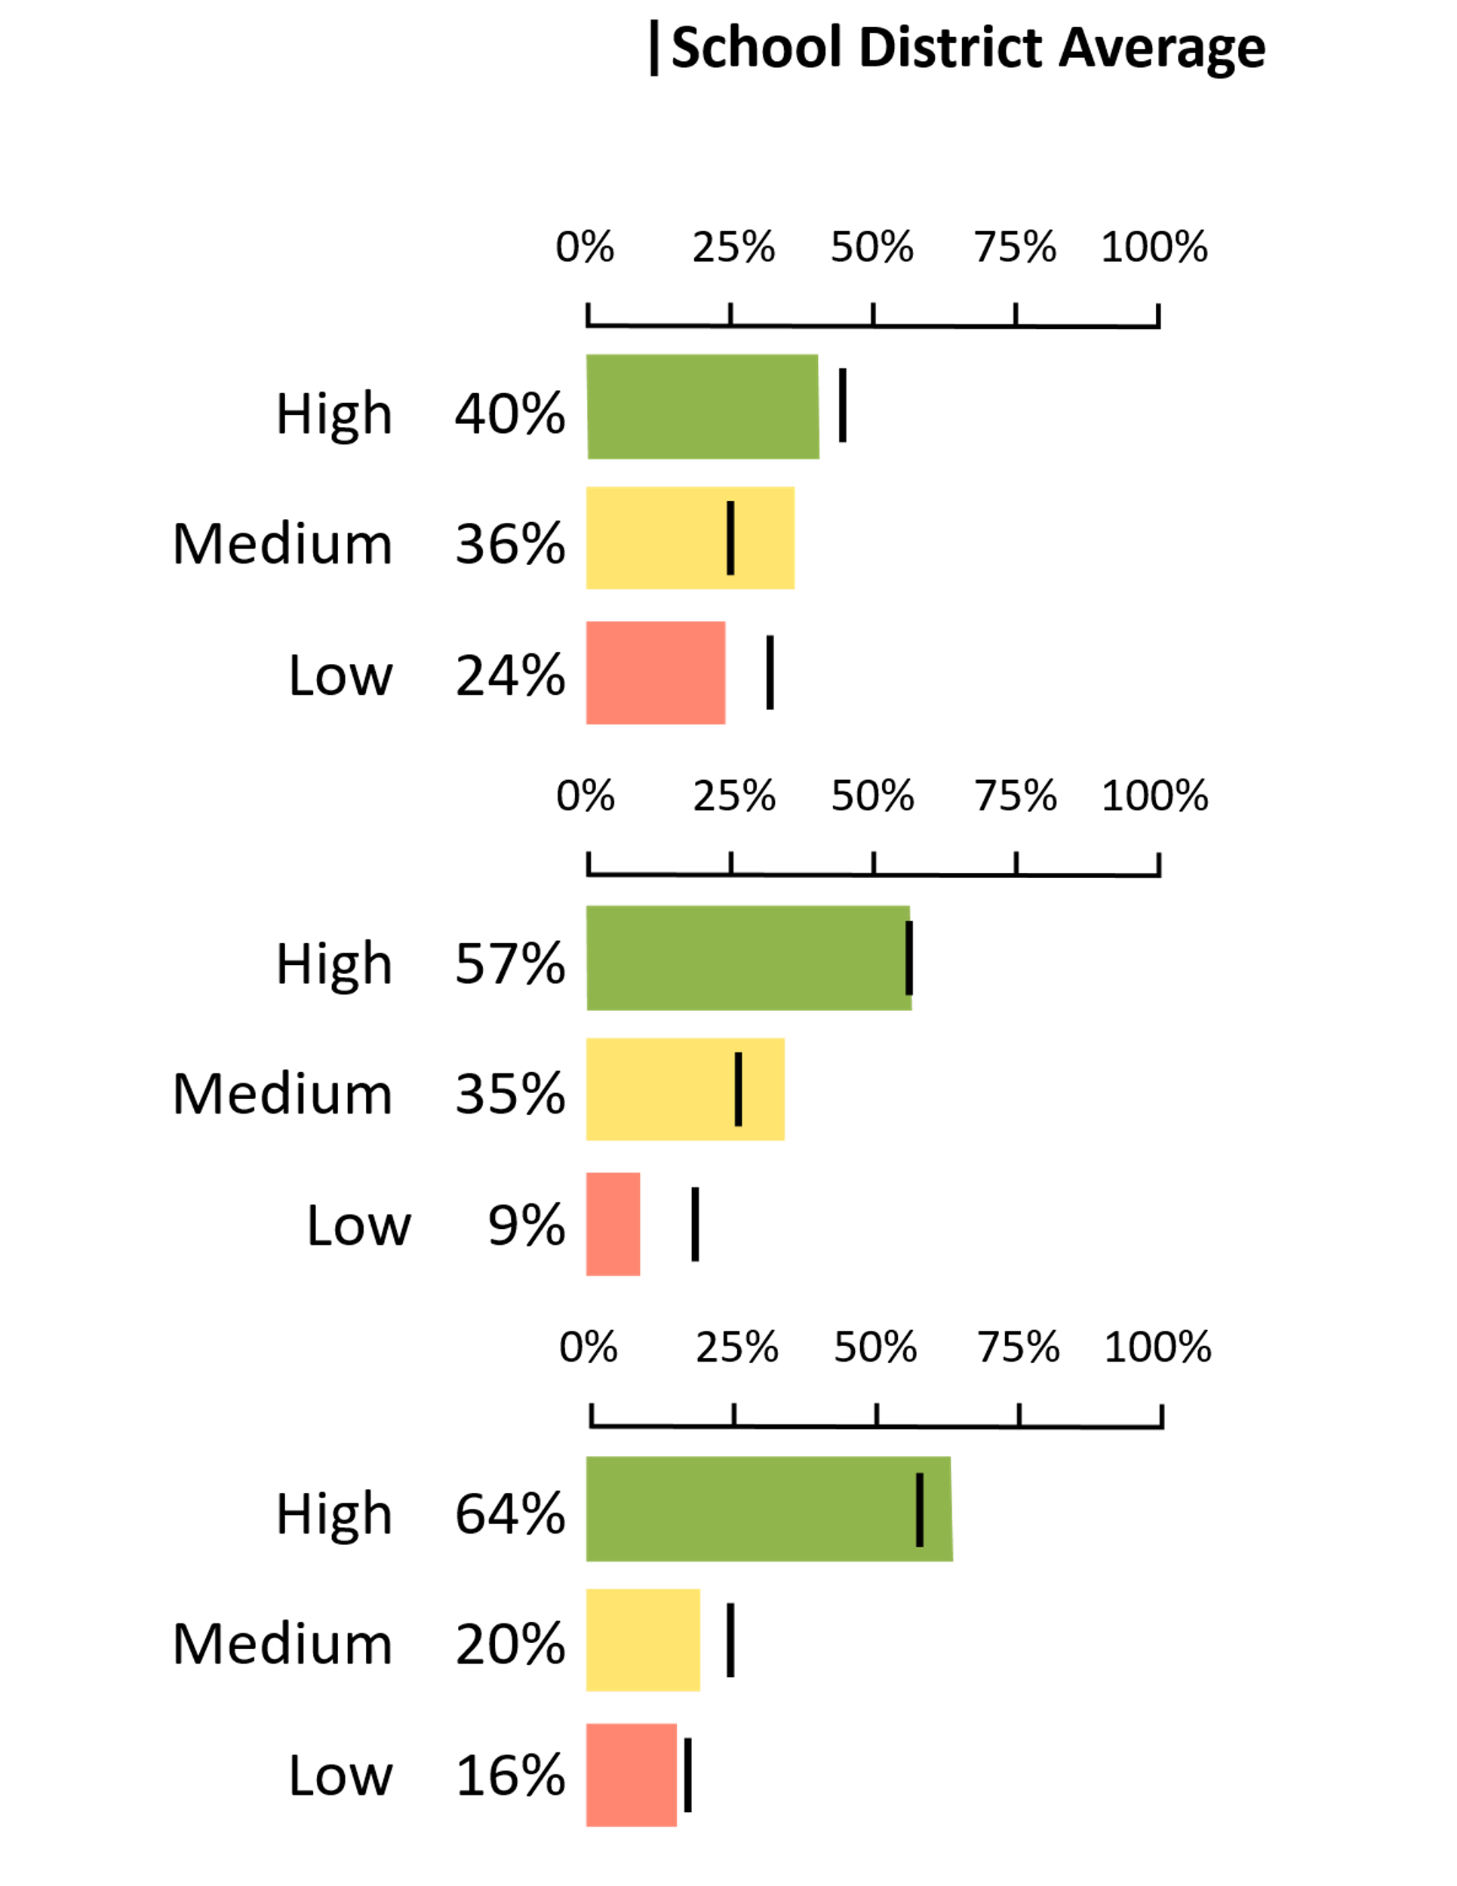
Activity 1: Reading MDI Results
RESULTS FOR STRAWBERRY SCHOOL
OPTIMISM
Optimism refers to the mindset of having positive expectations for the future. e.g., “I have more good times than bad times.”
EMPATHY
Empathy is the experience of understanding and sharing the feelings of others. e.g., “I care about the feelings of others.”
PROSOCIAL BEHAVIOUR
Prosocial behaviour refers to actions that benefit others.
e.g., “I helped someone who was hurt.”
Notes:
GUIDANCE
Tell students: MDI data are presented as bar graphs. Here’s an example from an imaginary school called Strawberry School. The bar graphs show the percentage of Strawberry School students in high, medium, and low categories for each measure. Notice the black line. It shows the district average so you can see where the school results are in comparison to their district’s results.
Explain further: You may also see results presented as tables and infographics.

Slide 7
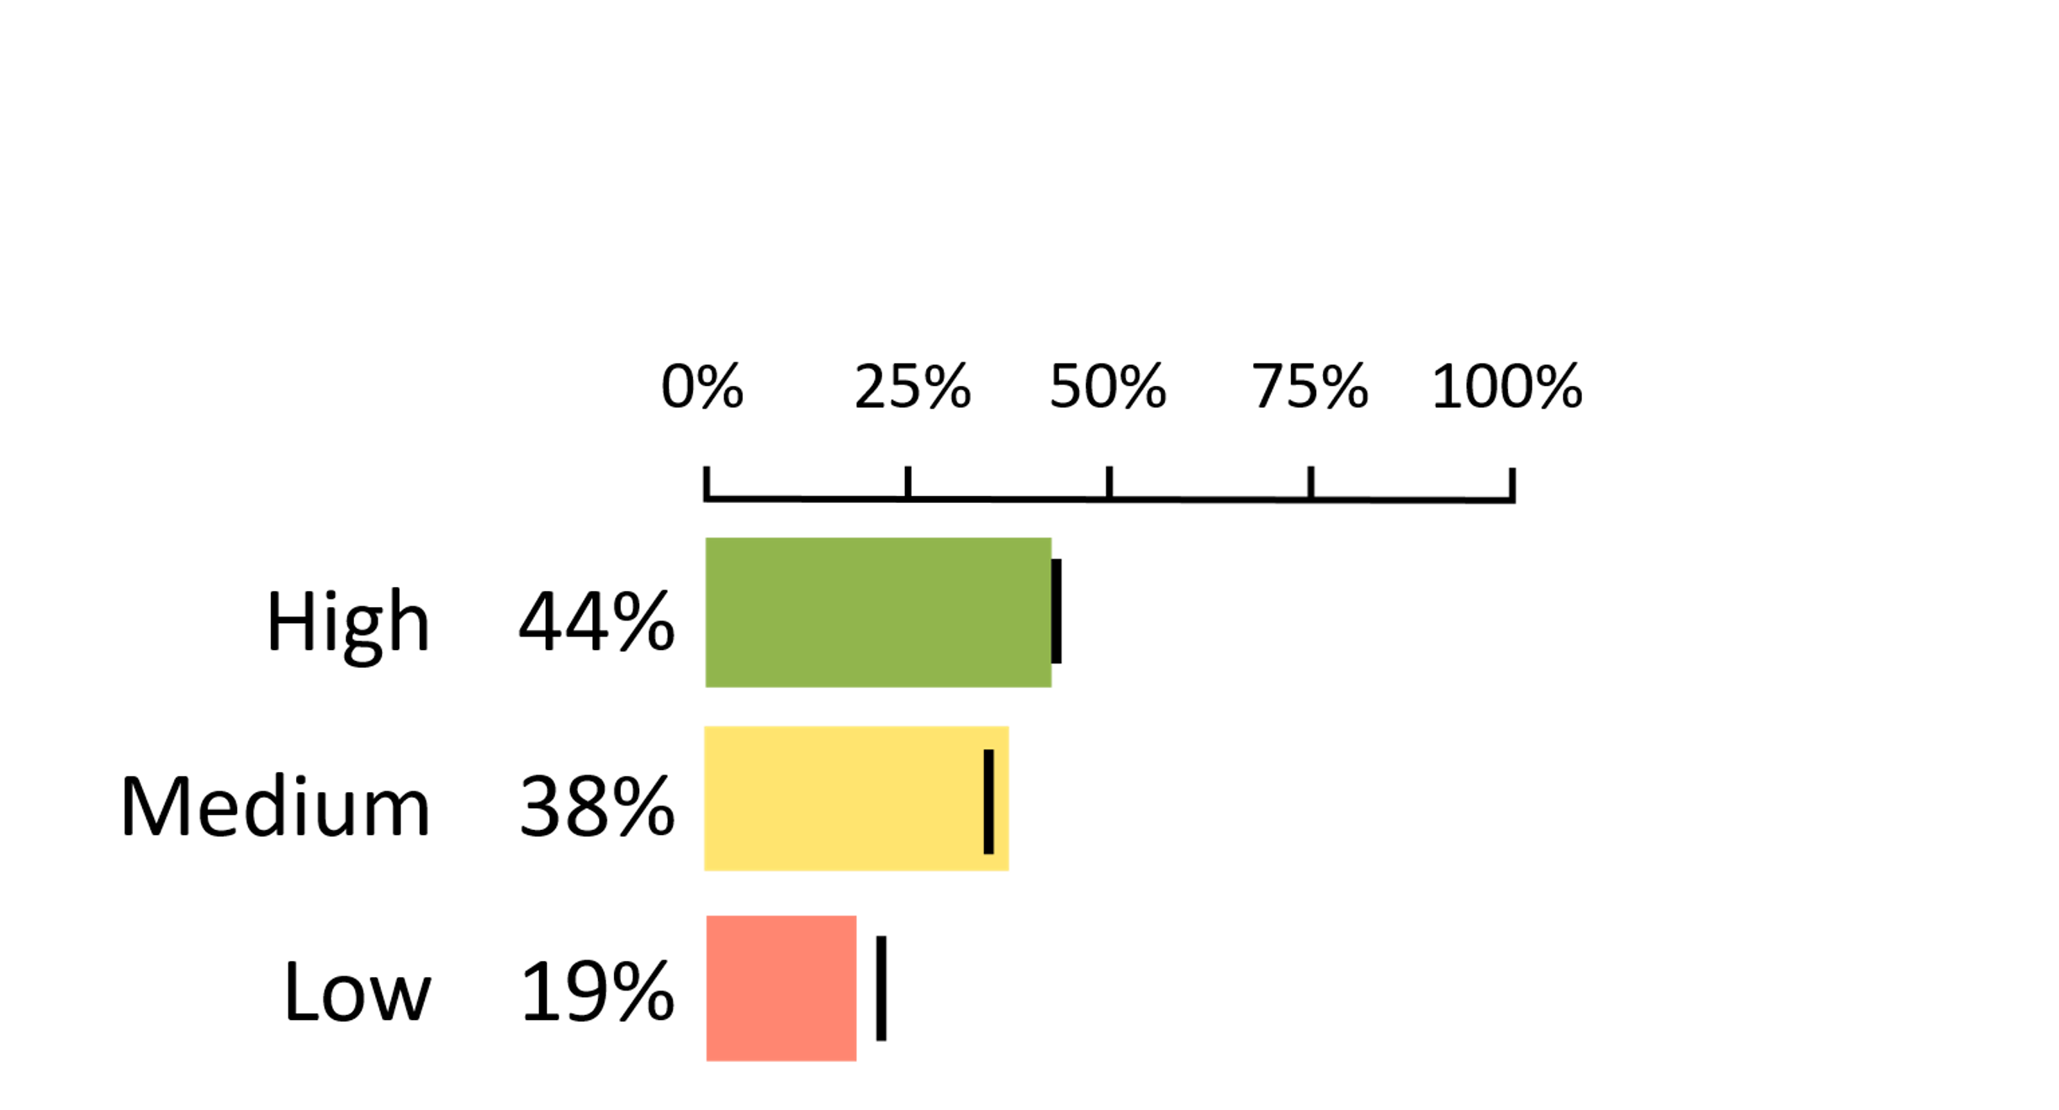
Activity 1
Skill Check 1
OPTIMISM
Optimism refers to the mindset of having positive expectations for the future. e.g., “I have more good times than bad times.”
Notes:
GUIDANCE
Introduce the activity: We're going to check your graph reading skills!
Ask students the following questions. Answers are in parentheses:
What percentage of students at this school are VERY optimistic? (44%)
How does that compare to the average for the district? (It is very close to the district average.)
What percentage of students at this school are not very optimistic at all (or pessimistic)? (19% have low optimism.)
Look at all three bar graphs together. Would you say that, in general, students at this school are more optimistic, less optimistic, or about the same as other students in the district? (The students at this school are very close to the average for the district, though there might be slightly higher percentage of students in medium and fewer in low compared to the rest of the district.)

Slide 8
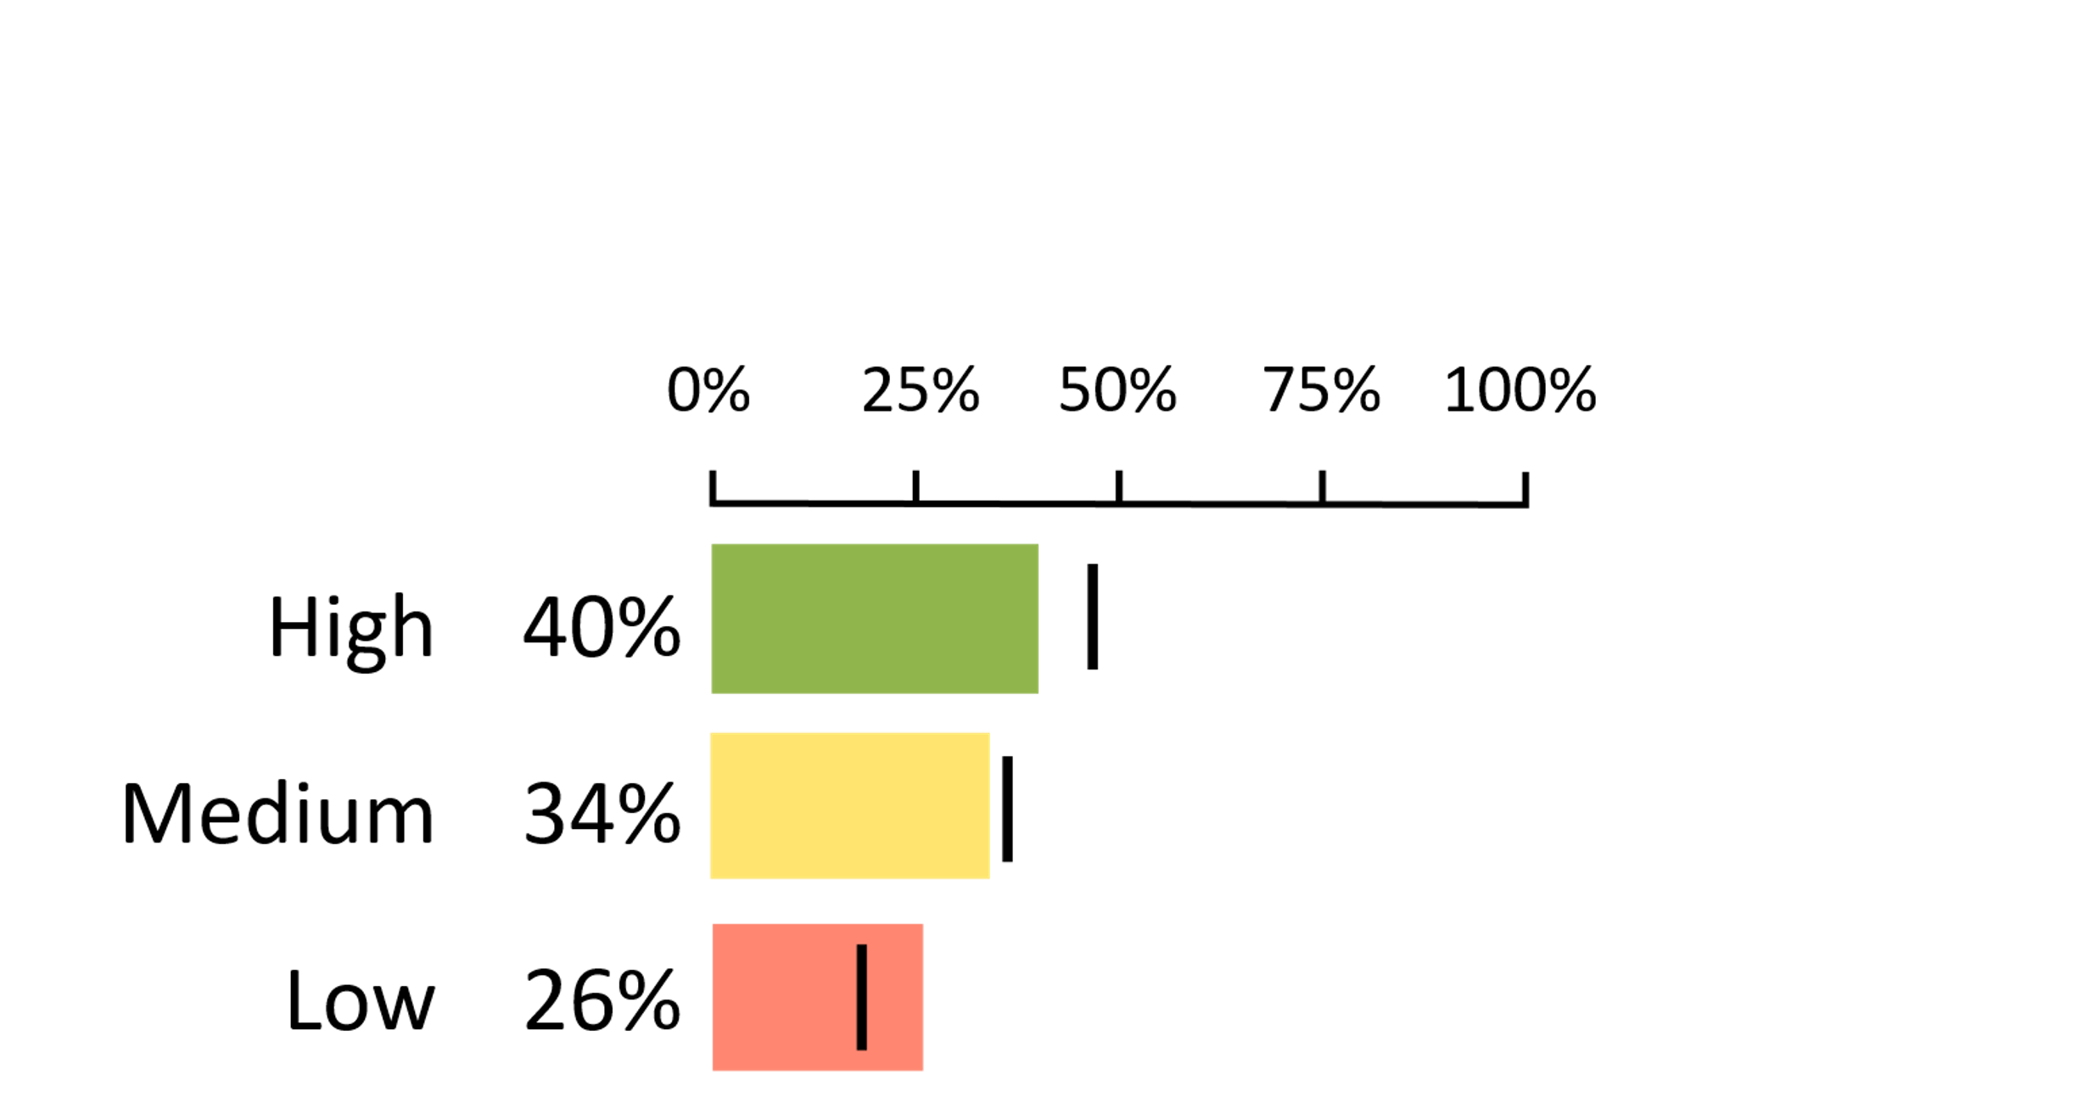
Activity 1
Skill Check 2
OPTIMISM
Optimism refers to the mindset of having positive expectations for the future. e.g., “I have more good times than bad times.”
Notes:
GUIDANCE
Tell students: Let’s look at a different school. Look at all three bar graphs together. Would you say that, in general, students at this school are more optimistic, less optimistic, or about the same as other students in the district? (The students at this school, in general, are less optimistic than other students. There is a lower percentage of students in the high category and more students in the low category.

Slide 9
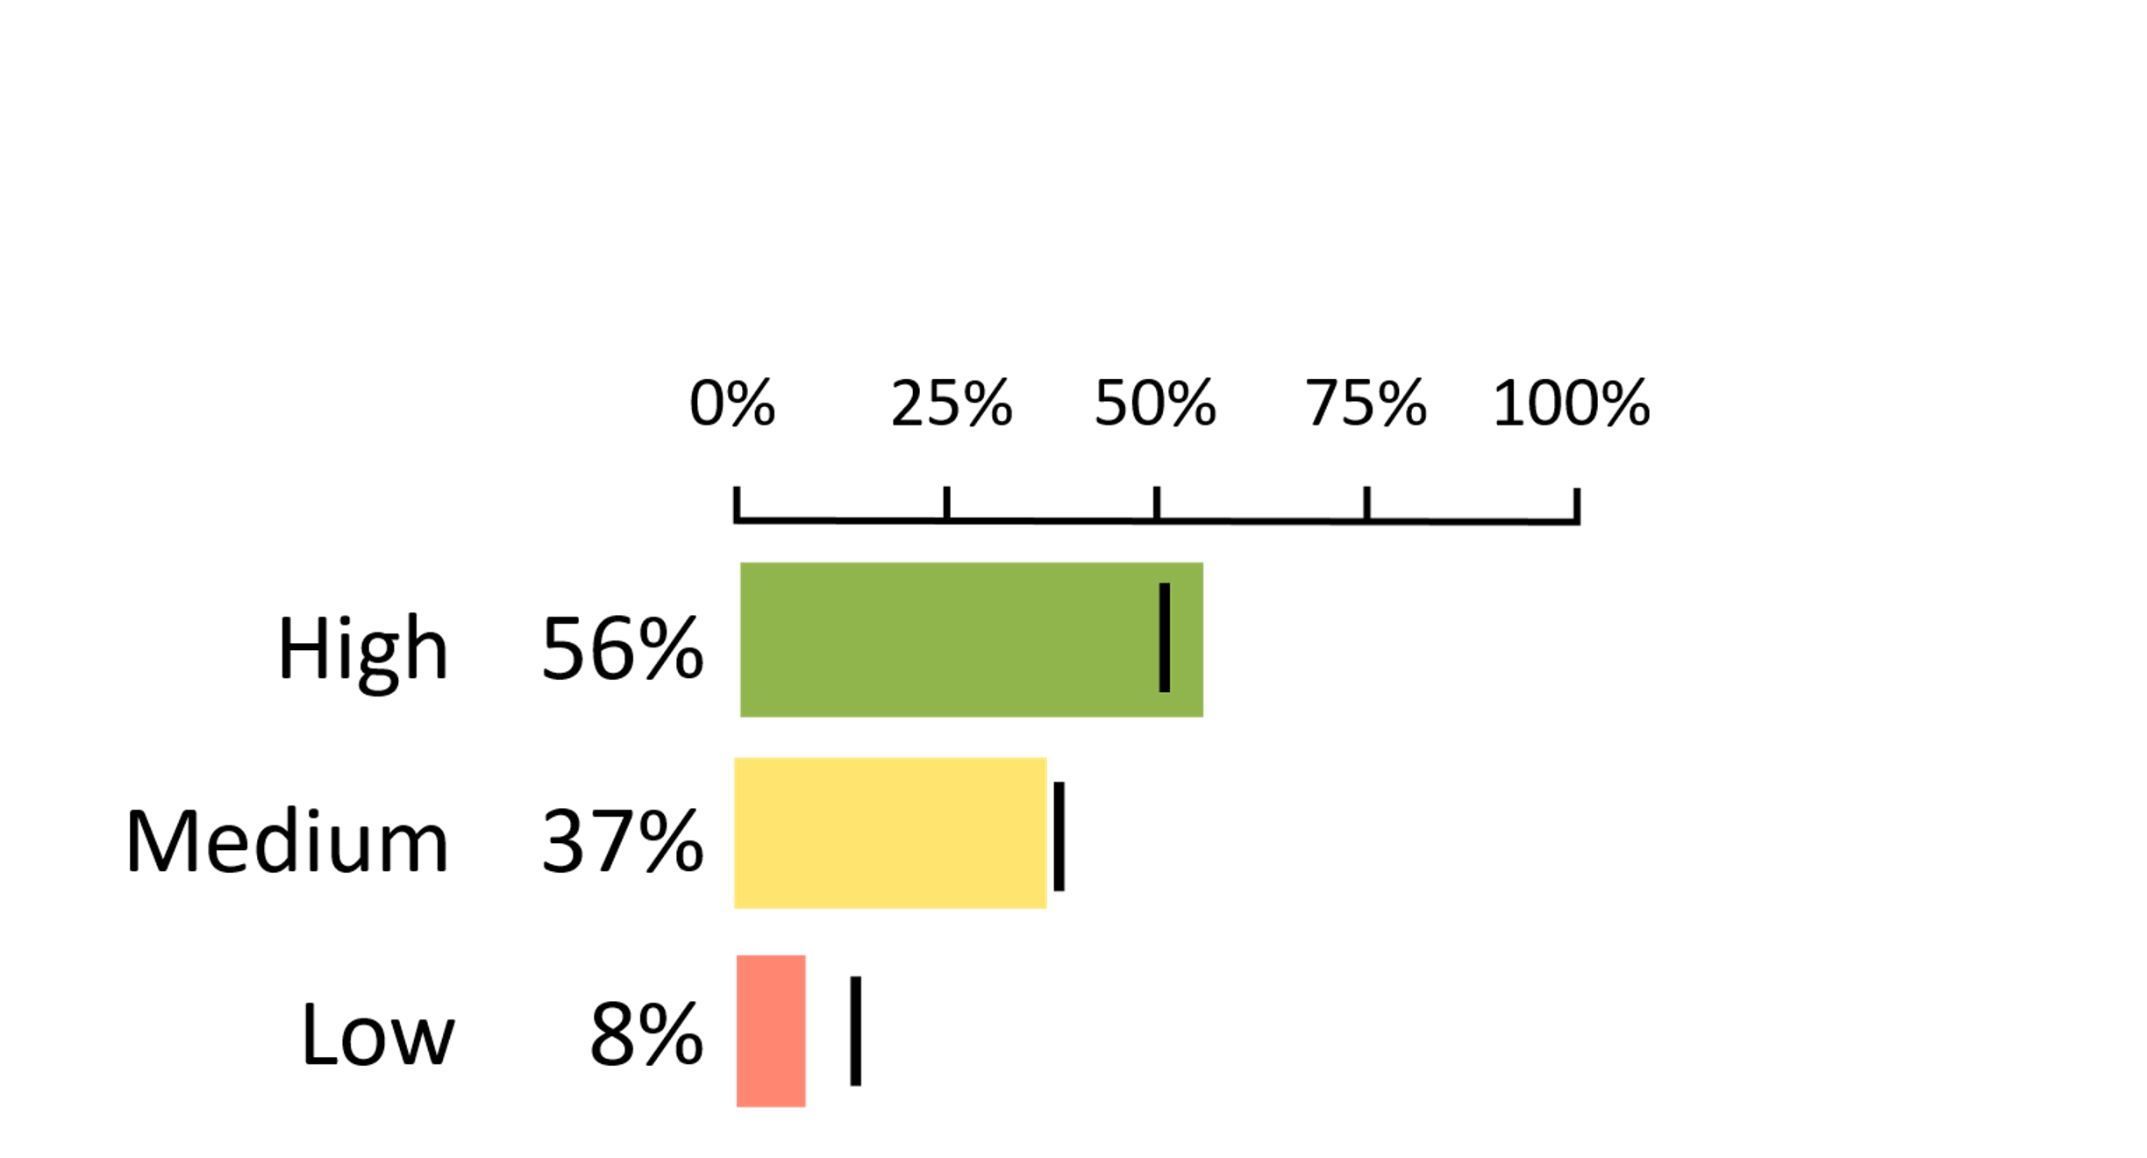
Activity 1
Skill Check 3
OPTIMISM
Optimism refers to the mindset of having positive expectations for the future. e.g., “I have more good times than bad times.”
Notes:
GUIDANCE
Tell students: Here’s one more example. Look at all three bar graphs together. Would you say that, in general, students at this school are more optimistic, less optimistic, or about the same as other students in the district? (The students at this school, in general, are more optimistic. There are more than average percentage of students in the high category and fewer students in the low category.)

Slide 10
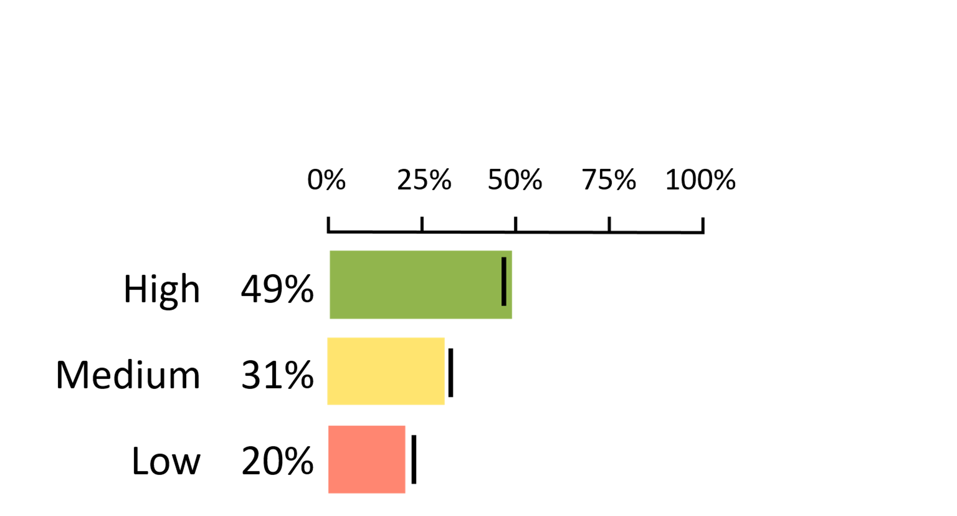
Activity 1
Absence of Worries and Absence of Sadness
ABSENCE OF SADNESS
Sadness measures the beginning symptoms of depression. e.g., “I feel unhappy a lot of the time.”
Notes:
GUIDANCE
Tell students: There are two measures which can be a bit confusing: “Absence of Sadness” and “Absence of Worries.” While it’s typical to be sad from time to time and have some worries, too much sadness or too many worries can have a negative effect. The wording on these measures is a bit confusing. ‘Absence’ is like being ‘absent’ meaning it is missing. So, if sadness is missing, it means the students are doing alright or are happy most of the time. That means for these slides green still means doing well, and red still means that the area is lower than we’d like.
Ask students: So, what percentage of students are quite sad or sad a lot of the time here? (20%)

Slide 11
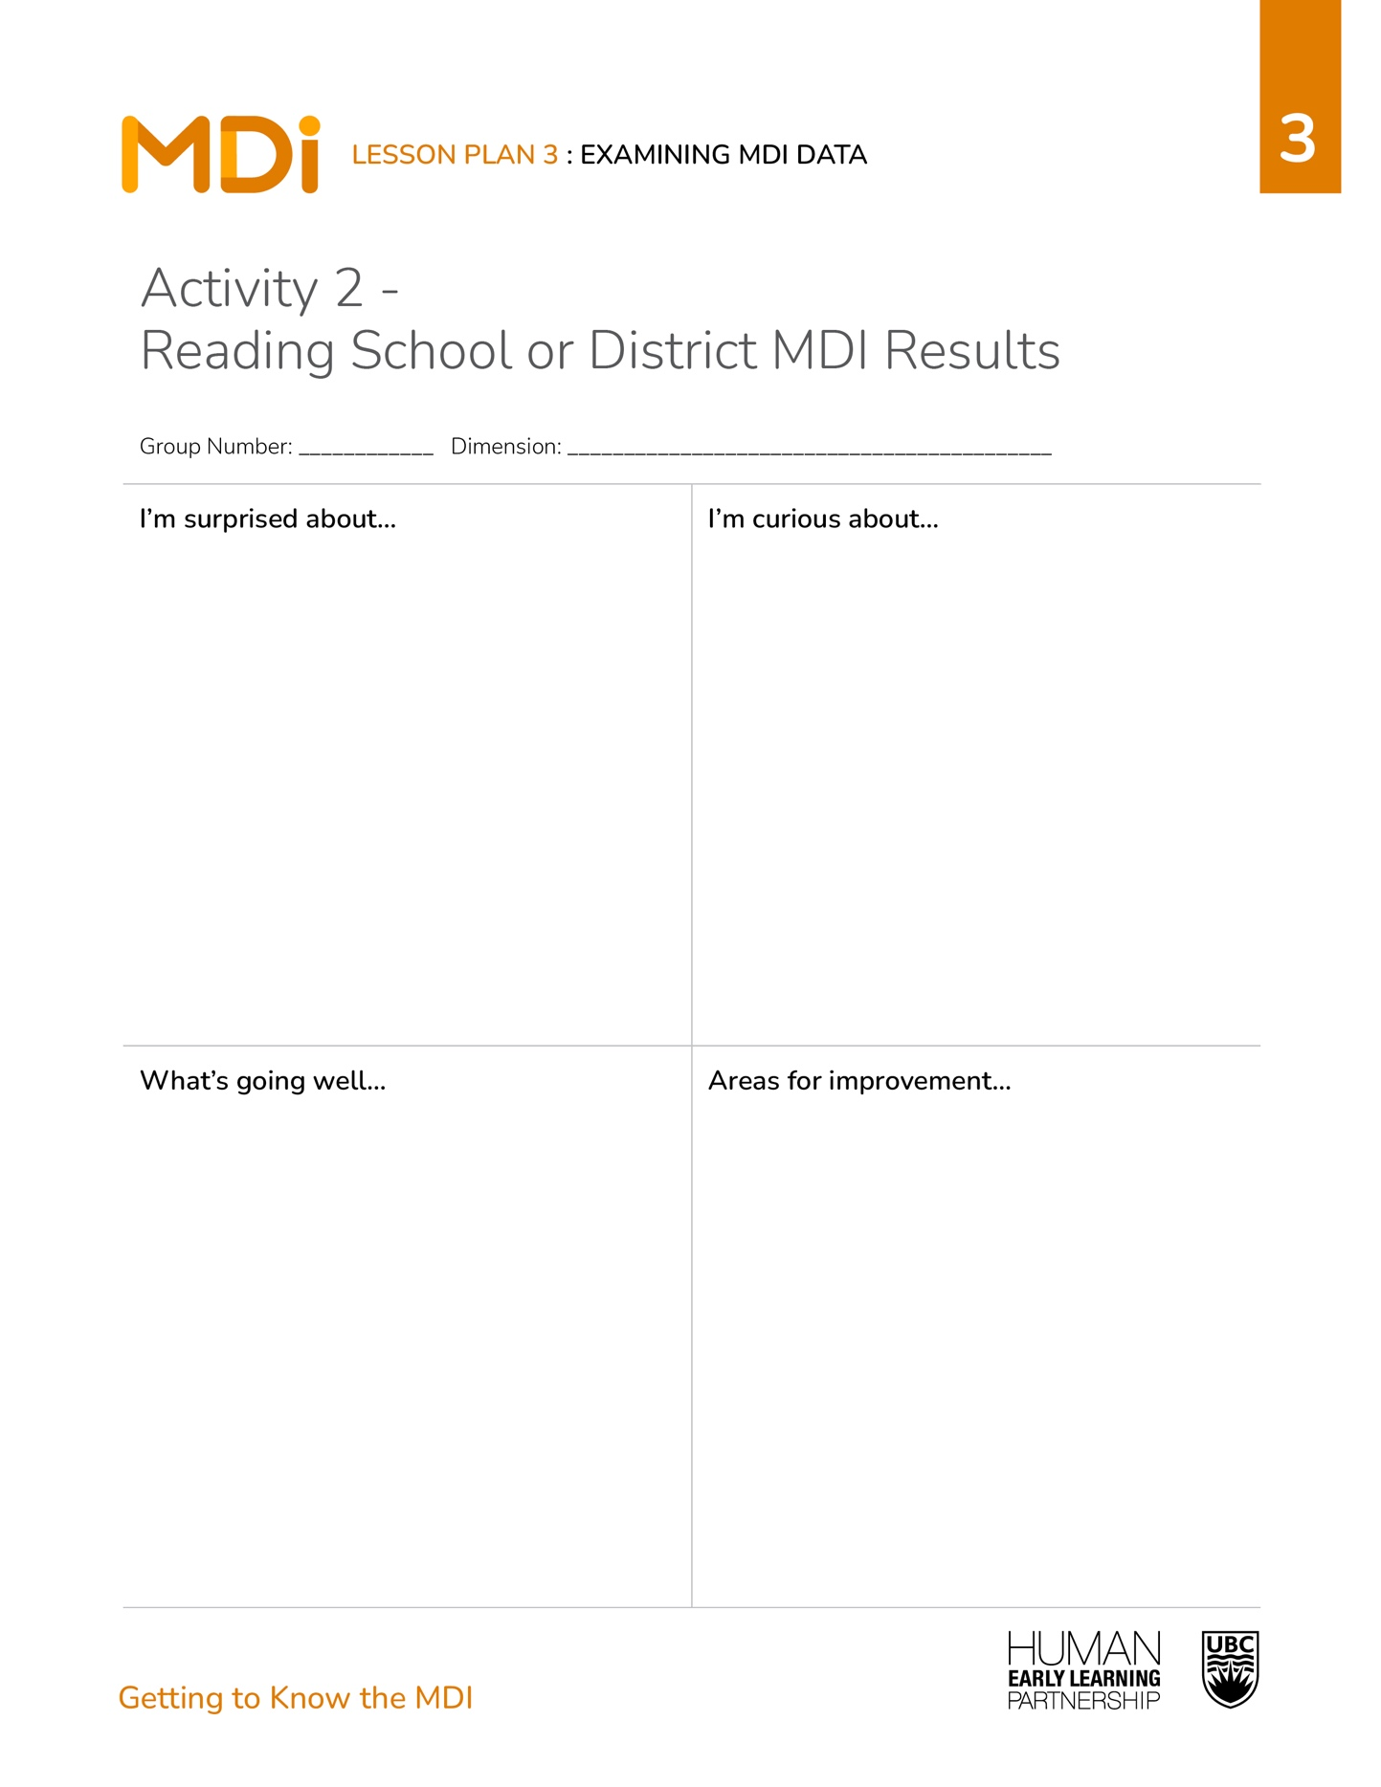
Activity 2
Directions
Number off by 5s.
Gather in small groups with your number groups.
Each group has the results for
one dimension.
Examine the results.
Discuss your impressions.
Record your ideas on your handout.
Notes:
GUIDANCE
Read the directions to students.
Give students 10-15 mins. to complete the activity in small groups.
© 2025 Human Early Learning Partnership

Slide 12

Activity 2
Class Discussion
What were some of the things you were surprised about/curious about?
Were you surprised/curious about some of the same things or different things as others in your group?
What do you think the school/district is doing well?
What do you think the areas of improvement are for the school/district?
Notes:
GUIDANCE
Have students return to their seats.
Use the prompts to have a class discussion.
Try to ensure at least one student from each dimension group responds to each question.
© 2024 Human Early Learning Partnership

Slide 13

Wrap-Up
Based on the data you examined, what’s one action you’d take to make a change in the school or district?
Notes:
GUIDANCE
Tell students: Today you practiced reading and interpreting MDI results.
Ask students: Based on the data you examined, what’s one action you’d take to make a change in the school or district?
© 2025 Human Early Learning Partnership

