Slide 1



Exploring Assets
Instructor Name, Date
Middle Years Development Instrument
Notes:
GUIDANCE
Optional: Customize this slide with the instructor’s name and lesson delivery date
© 2025 Human Early Learning Partnership

Slide 2


Introduction
What are “assets”?
Turn to the person next to you and share your definition of an asset.
Notes:
GUIDANCE
Read the question.
Invite students to turn to the person next to them and share their definition of an asset.
Then invite students to share their ideas.
© 2025 Human Early Learning Partnership

Slide 3
Introduction
Assets
Resources present in children’s lives such as supportive relationships and activities that can provide positive experiences for students
Developed by families, school, communities, and kids themselves
Help kids be happy, healthy, and do well in life
Notes:
GUIDANCE
Read points on screen defining “assets.” Connect with points students offered in their definitions.
© 2025 Human Early Learning Partnership

Slide 4
Activity 1
MDI Assets
Adult Relationships Adults at school Adults in the neighbourhood Adults at home | Peer Relationships Peer belonging Friendship intimacy
Nutrition & Sleep Eating breakfast Meals at home with your family Frequency of good sleep | Out-of-School Activities Organized activities
Notes:
GUIDANCE
Tell students: The MDI measures four key categories of assets: read each asset category and its sub-categories.

Slide 5
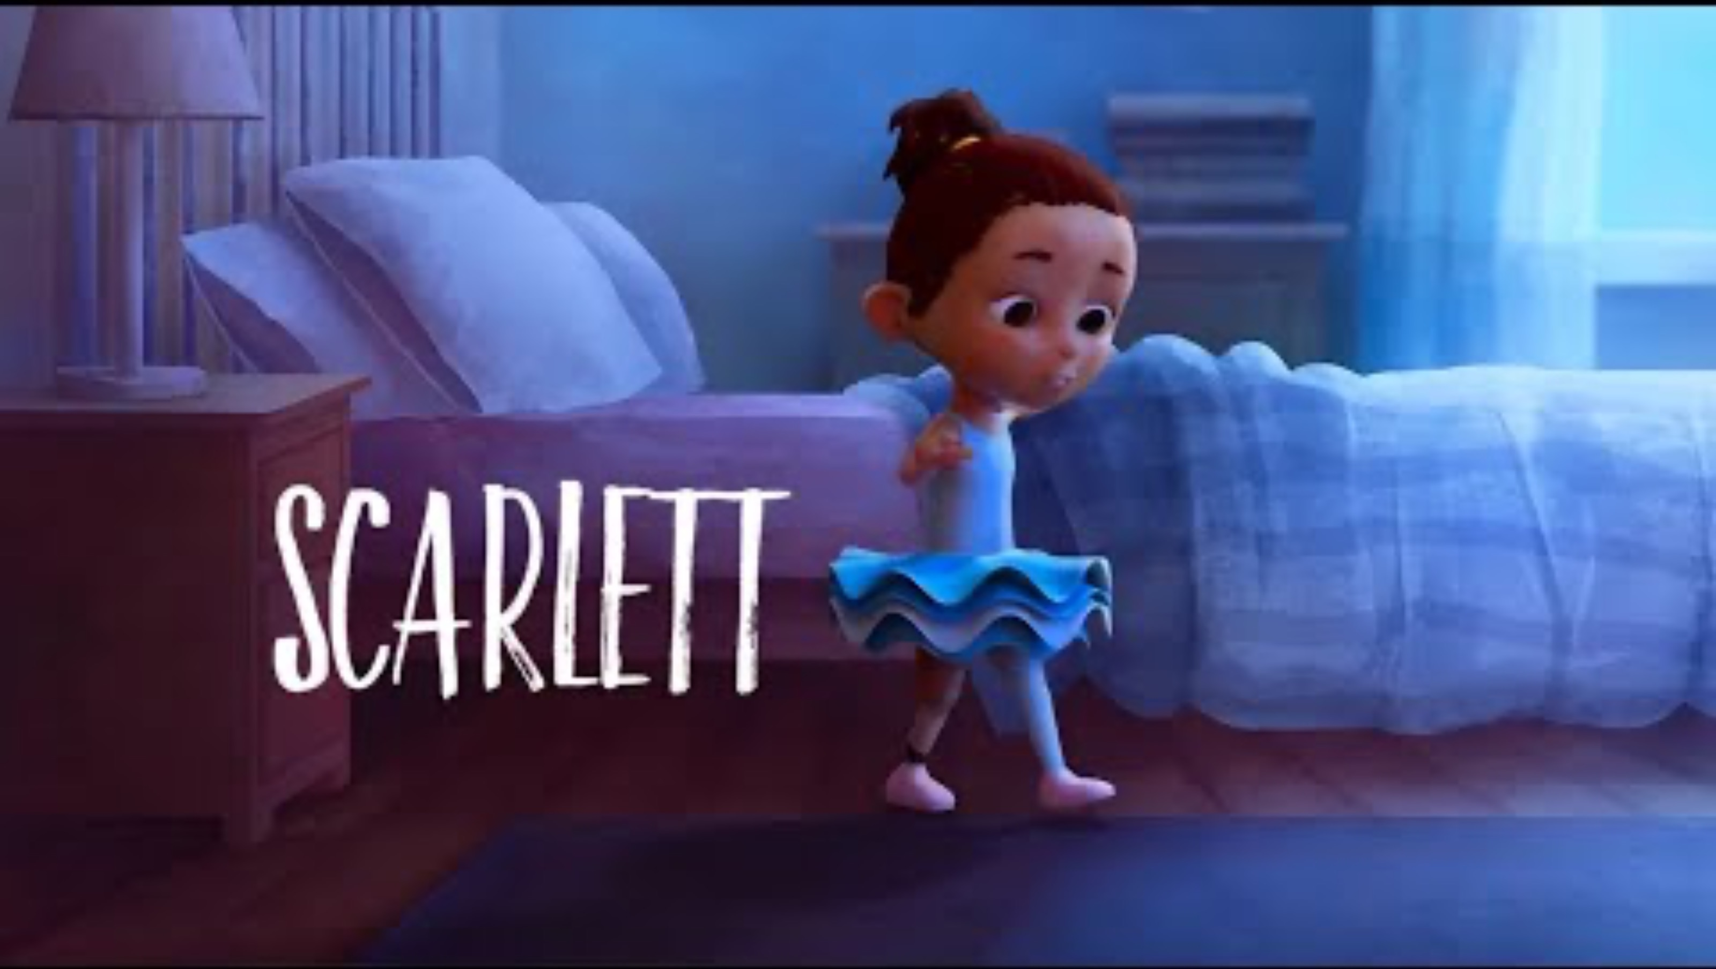
Activity 1
Notes:
GUIDANCE
Tell students: We’re going to watch a short, animated film about a girl called Scarlett. As you watch, try to identify the assets that are helping her through a challenging time.
Play the film (2:49 mins.)

Slide 6

Activity 1
What assets did Scarlett have?
Share your ideas with the class.
Notes:
GUIDANCE
Give student time to think about Scarlett’s assets. Then invite them to share with the whole class.

Slide 7
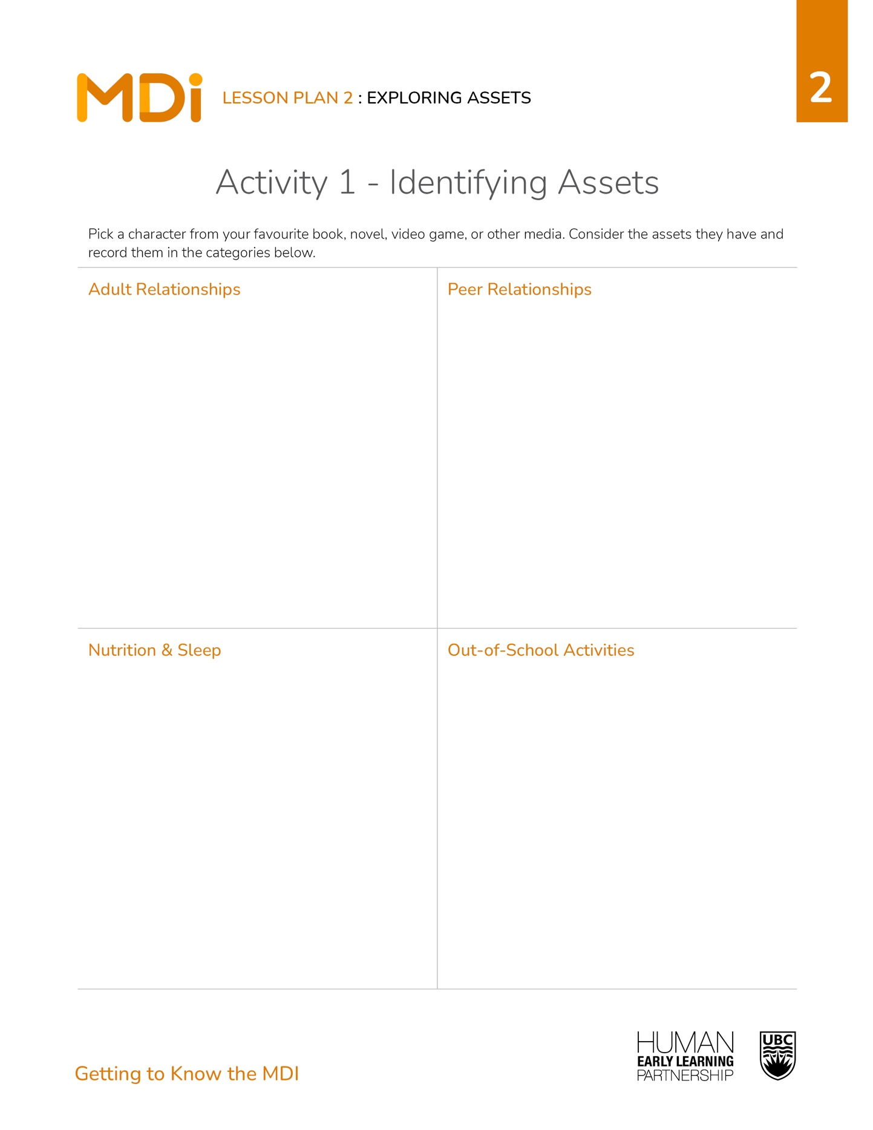
Activity 1
Directions
Pick a character from your favourite book, novel, video game, or other media.
Consider the assets they have and record them in the categories on your handout.
Share your character and their assets with the class.
Notes:
GUIDANCE
Read the directions to students.
Distribute the Lesson 2 handout, one per student.
Give students 4-6 mins. to complete the activity individually or in pairs/small groups.
When most students have some ideas down, invite them to share the character and their assets with the whole class.
© 2025 Human Early Learning Partnership

Slide 8

Activity 2
Notes:
GUIDANCE
Tell students: Assets are linked to your well-being. The more assets young people have in their lives, the happier and healthier they’ll be!
Introduce video: Let’s listen to one of the creators of the survey, Dr. Kim Schonert-Reichl, talk about how assets are related to well-being.
© 2025 Human Early Learning Partnership

Slide 9
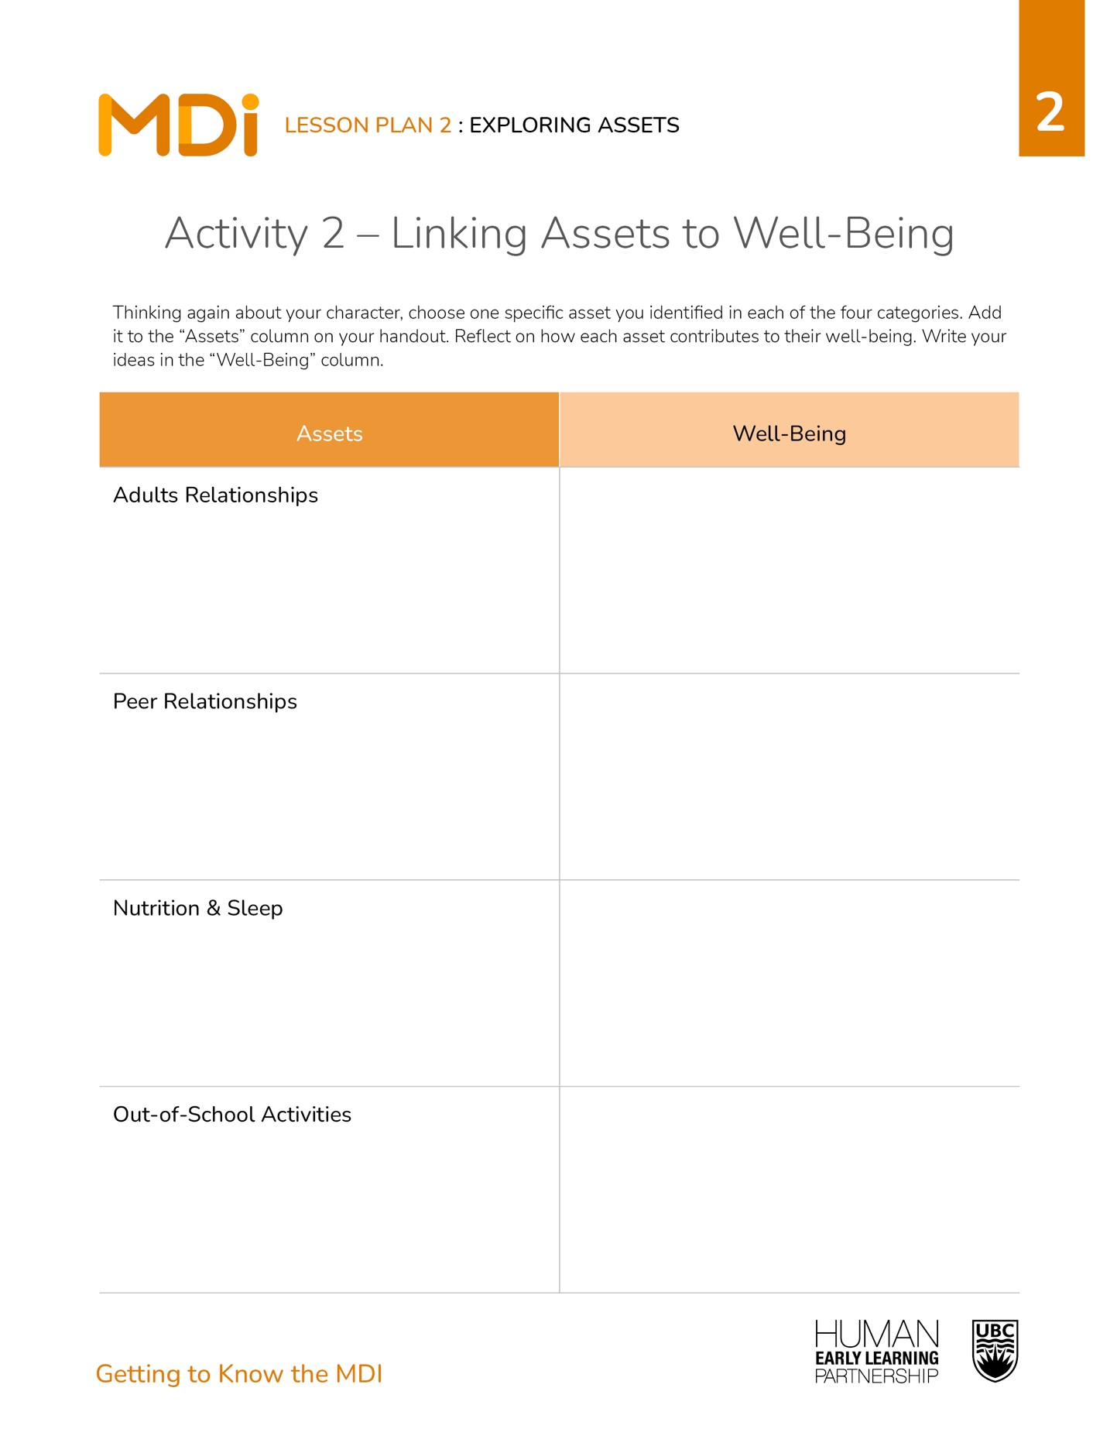
Activity 2
Directions
Thinking again about your character, choose one specific asset you identified in each of the four categories. Add it to the “Assets” column on your handout.
Reflect on how each asset contributes to their well-being.
Write your ideas in the “Well-Being” column.
Notes:
GUIDANCE
Read the directions to students.
Give students 4-6 mins. to complete the activity individually or in pairs/small groups.
When most students have some ideas down, invite them to share how their character’s assets are related to their well-being with the whole class.
© 2025 Human Early Learning Partnership

Slide 10

Wrap-Up
Assets are related to your well-being!
Notes:
GUIDANCE
Tell students: Today you learned more about the assets measured by the MDI and how they’re related to well-being.
Invite students to complete the exit ticket before they transition to the next activity: Have students state out loud or record a positive influence or asset in their life or in Scarlett’s life from the video.
© 2025 Human Early Learning Partnership

