Slide 1



What is the MDI?
Instructor Name, Date
Middle Years Development Instrument
Notes:
GUIDANCE
Optional: Customize this slide with the instructor’s name and lesson delivery date
© 2025 Human Early Learning Partnership

Slide 2


Introduction
In what ways are you asked to give your opinions about how you’re doing?
Do you feel your opinions are listened to by the adults around you?
Why or why not?
Notes:
GUIDANCE
Read the questions. Give students time to think, then invite a few students to share their ideas.
© 2025 Human Early Learning Partnership

Slide 3

Introduction
Article 12, UN Convention on the Rights of a Child:
Children have a right to give their opinion and be listened to by the adults around them.
How could a survey help you feel heard?
Notes:
GUIDANCE
Tell students that Article 12 of the United Nations Convention on the Rights of a Child describes their right to give their opinion and be listened to by the adults around them.
Ask students how a survey could help them feel heard.
© 2025 Human Early Learning Partnership

Slide 4


Introduction
The Middle Years Development Instrument
Notes:
GUIDANCE
Tell students: Hearing directly from youth about their life, their experiences, and how they’re doing is important! Today you’re going to learn about one way we’re listening to your opinions about these important topics with the Middle Years Development Instrument or MDI.
© 2025 Human Early Learning Partnership

Slide 5

Activity 1
The MDI is a self-report survey for children in Grades 4 to 8
1
Notes:
GUIDANCE
Tell students: There are several key features of the MDI’s survey design that make it a great way to learn your opinions. First, it’s a self-report survey. That means it’s completed by YOU!
Optional—Expand on this topic: The MDI is a survey completed by students (that’s what makes it a self-report -- teachers or other adults are not filling out surveys about their students). Students in Grades 4 through 8 complete the MDI during class time, under supervision of an educator such as a teacher, counsellor, or principal. Previous research has found that responses from children in grade 4 and above are as reliable and valid as responses from adults.
Further Reading on the validity of children’s self-report:
Schonert-Reichl, K., Guhn, M., Gadermann, A., Hymel, S., Sweiss, L., & Hertzman, C. (2013). Development and validation of the Middle Years Development Instrument (MDI): Assessing children’s well-being and assets across multiple contexts. Social Indicators Research, 114(2): 345-369.
Varni, J. , Limbers, C. , & Burwinkle, T.(2007). How young can children reliably and validly self-report their health-related quality of life?: An analysis of 8,591 children across age subgroups with the PedsQL™ 4.0 Generic Core Scales. Health and Quality of Life Outcomes, 5(1): 1-13.
http://earlylearning.ubc.ca/mdi/
© 2025 Human Early Learning Partnership

Slide 6

Activity 1
The MDI focuses
on strengths
2
Notes:
GUIDANCE
Tell students: Second, the MDI’s questions focus on strengths and the positive aspects of your lives. They give you a chance to think about these and share your reflections with adults, often for the first time.
Optional—Expand on this topic: The MDI is not a rating tool or a report card. Information from the MDI can help schools and communities understand where their students are already strong and point the way to growing even stronger. The MDI can help adults understand areas that have great significance in children’s lives, beyond schoolwork and academics. By reviewing and sharing MDI results, teachers, principals, and other people who make decisions at school and in the community can better understand the opinions and concerns of their children. Also, decision-makers can be more informed and better prepared to move toward actions that will create supportive environments where children can thrive.
© 2025 Human Early Learning Partnership

Slide 7

Activity 1
.
3
The MDI is a population-based survey
Notes:
GUIDANCE
Tell students: The MDI is a population-based survey. That means it provides data on groups, not individuals. It helps us see patterns across a school community or district.
Optional—Expand on this topic: Population-based survey which means that all students in a school district are invited to take the survey. While individual students complete the MDI, the results are not used to evaluate or grade individual children. The results are not used to rank teachers, neighbourhoods, schools, or school districts either. The value of MDI data lies not in measuring the strengths and needs of one student or one class, but in seeing patterns across a community or district, and across time for groups of children during middle childhood. The results from the MDI:
Tell us only about groups, so a grade (not a class) at the school, neighbourhoods, or broader geographic regions such as a school district and the communities within it.
Allow us to understand the well-being of groups of children (in a school, community, or school district).
Are not used to evaluate individual students.
Are not used to evaluate teachers or schools.
© 2025 Human Early Learning Partnership

Slide 8
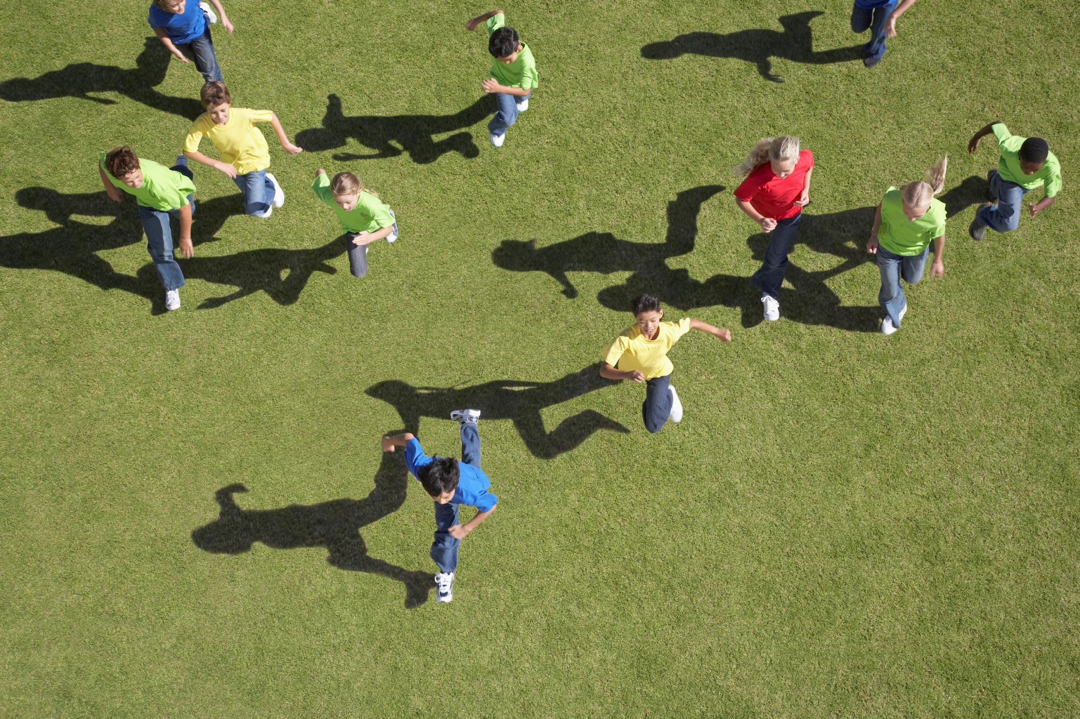
Activity 1
.
4
The MDI measures changeable skills and habits
Notes:
GUIDANCE
Tell students: Fourth, the skills and habits measured by the MDI are things that you can learn and strengthen right now. So, what we learn from the MDI data helps us take action and make changes to support your learning and development.
Optional—Expand on this topic: It’s important to remember that the skills and habits that are measured by the MDI are things that can be learned and strengthened during middle childhood (and early adolescence in the case of Grade 8). This is especially true of social-emotional and relationship-building skills. Research continues to identify programs and practices targeting these skills that demonstrate positive, long-term outcomes for children. Middle childhood is the perfect time to begin modeling positive behaviour, practicing social-emotional skills, and supporting new healthy habits. We also know that the assets that support middle years well-being are actionable–which means that we can intentionally build relationships with children, provide them with enriching out-of-school programs, and cultivate classroom and school environments that make every student feel like they belong.
© 2025 Human Early Learning Partnership

Slide 9

Activity 1
5
The MDI listens
to children’s voices
Notes:
GUIDANCE
Tell students: Children’s voices matter. So, the fifth and most important feature of the MDI’s survey design is that it listens to children’s voice. It helps us get good information on child well-being that would be hard to access otherwise. And it gives you a say in how your school and community make changes to support you.
Optional—Expand on this topic: One of the core beliefs of the MDI is that children’s voices deserve to be heard. Asking children for their input is valuable because it provides us with good information on child well-being that we couldn’t otherwise access – information which we can use to create environments and interactions which help children thrive. It’s also powerful because it tells children that we value their thoughts and feelings.
© 2025 Human Early Learning Partnership

Slide 10
Activity 1
Directions
Discuss the five key features of the MDI survey’s design with your partner or small group members.
Work together to record the five key features on your handouts.
If you have more time, add details that explain more about each key feature.
Check your work!
Five key survey design features:
Self-report survey
Focuses on strengths
Population-based survey
Measures changeable skills and habits
Listens to children's voices
Notes:
GUIDANCE
Read the directions to students.
Distribute the Lesson 1 handout, one per student.
Give students 5-7 mins. to complete the activity. Students who finish quickly can add details about each feature to their list.
Animate in the list of five key features and have students check their work.
© 2025 Human Early Learning Partnership

Slide 11
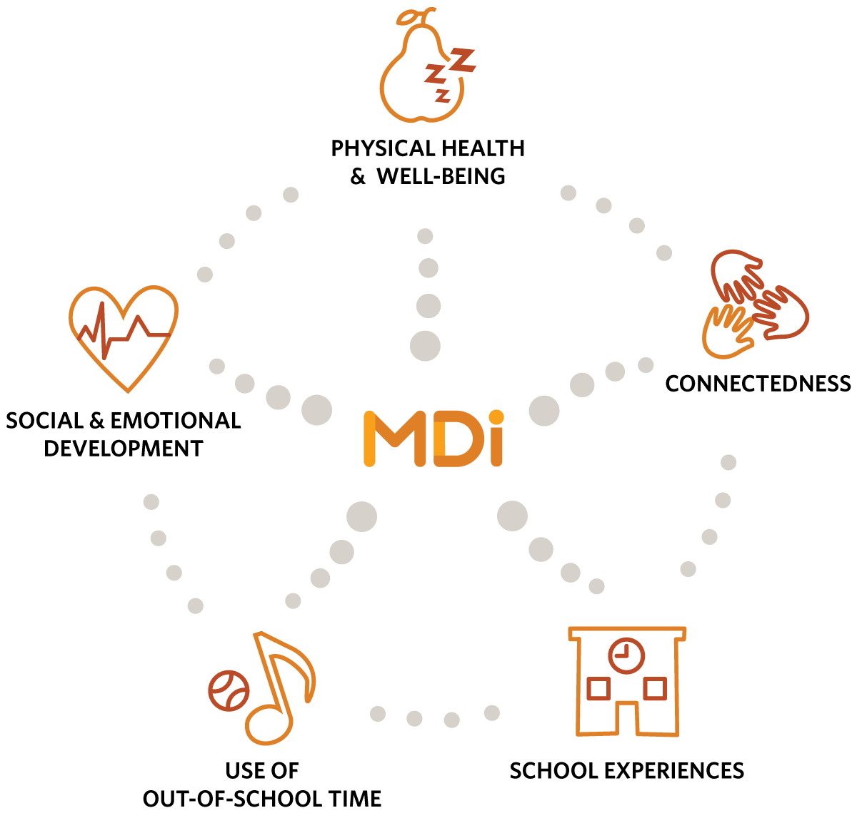
Activity 2
MDI Dimensions
Measure areas of growth and development strongly linked to well-being, health,
and academic achievement
Notes:
GUIDANCE
Tell students: The MDI measures five areas or dimensions of growth and development that are strongly linked to well-being. They are: Physical Health and Well-Being, Connectedness, School Experiences, Use of Out-of-School Time, and Social & Emotional Development.
Optional—Expand on the topic: Each dimension of the MDI is made up of individual measures (for example, the Connectedness Dimension of the MDI includes questions about the number of important adults at school, relationships with adults at home, and peer belonging). Have students visit the website: http://earlylearning.ubc.ca/mdi/
© 2025 Human Early Learning Partnership

Slide 12
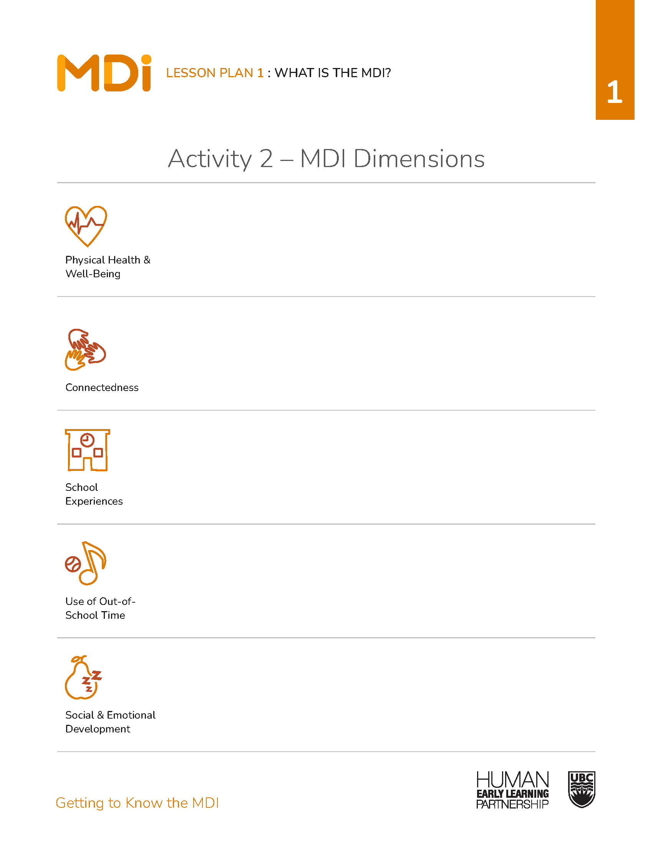
Activity 2
Directions
Dimension groups: Work together to fill the graphic organizer section for your dimension with examples of the skills, experiences, etc., that support growth and development in that dimension.
Jigsaw groups: Take turns presenting your dimension examples with the group. Remember to take notes!
Notes:
GUIDANCE
Have students number off from 1-5. Have all 1s gather in one area, all 2s, etc. until everyone is in one of the five dimension groups.
Read the directions to students.
Give students 5 mins. to work together to add examples of skills, experiences, and so on, that support growth and development in their dimension to the graphic organizer on their handouts.
Have students move into five jigsaw groups, with one student from each dimension group represented (i.e., each group has a group 1 person, group 2 person, and so on).
Have each group member share examples from their dimension with the rest of the group. Make sure students take notes to fill out the graphic organizer on their handout.
If time allows, have students from each jigsaw group share their examples with the whole group.
© 2025 Human Early Learning Partnership

Slide 13
Activity 2
Physical Health & Well-Being | Connectedness | School Experiences | Use of Out-of-School Time | Social & Emotional Development
General Health Meals with Adults in Your Family Frequency of Good Sleep Eating Breakfast Physical Activity Transportation to and from School Help-Seeking for Emotional Well-Being | Connectedness to Adults (home, school, neighbourhood) Connectedness to Peers | School Climate School Belonging Academic Self-Concept Victimization & Bullying | Organized Activities (sports, arts, clubs, educational) How Students Spend their Time How Students Wish to Spend their Time | Empathy Optimism Self-Regulation Prosocial Behaviour Absence of Sadness Absence of Worries Happiness Self-Esteem Self-Awareness Responsible Decision-Making Citizenship & Social Responsibility Concern for the Environment
Notes:
GUIDANCE
Tell students: This table shows what topics are measured in each dimension. Compare this with the examples you and your groups came up with. How are they the same? How are they different? Give students time to compare and think, then invite students to share their ideas. If students are finding the language challenging, show them items from the survey that are in child-friendly language.
Extension: Have students rank dimensions and/or examples within each dimension from most to least important to them personally or socially.
© 2025 Human Early Learning Partnership

Slide 14

Wrap-Up
Your voices matter!
Notes:
GUIDANCE
Tell students: Today you learned about the Middle Years Development Instrument, or MDI, including its five key survey design features and the dimensions of growth and development it measures. The MDI is a great way for you to share your opinions about your life and experiences with adults so we can take action to make this school and community one where you can thrive.
(Optional) Invite students to complete the exit ticket before they transition to the next activity: Have students state out loud or record one or more of the dimensions measured in the MDI.
© 2025 Human Early Learning Partnership

